Slide 1
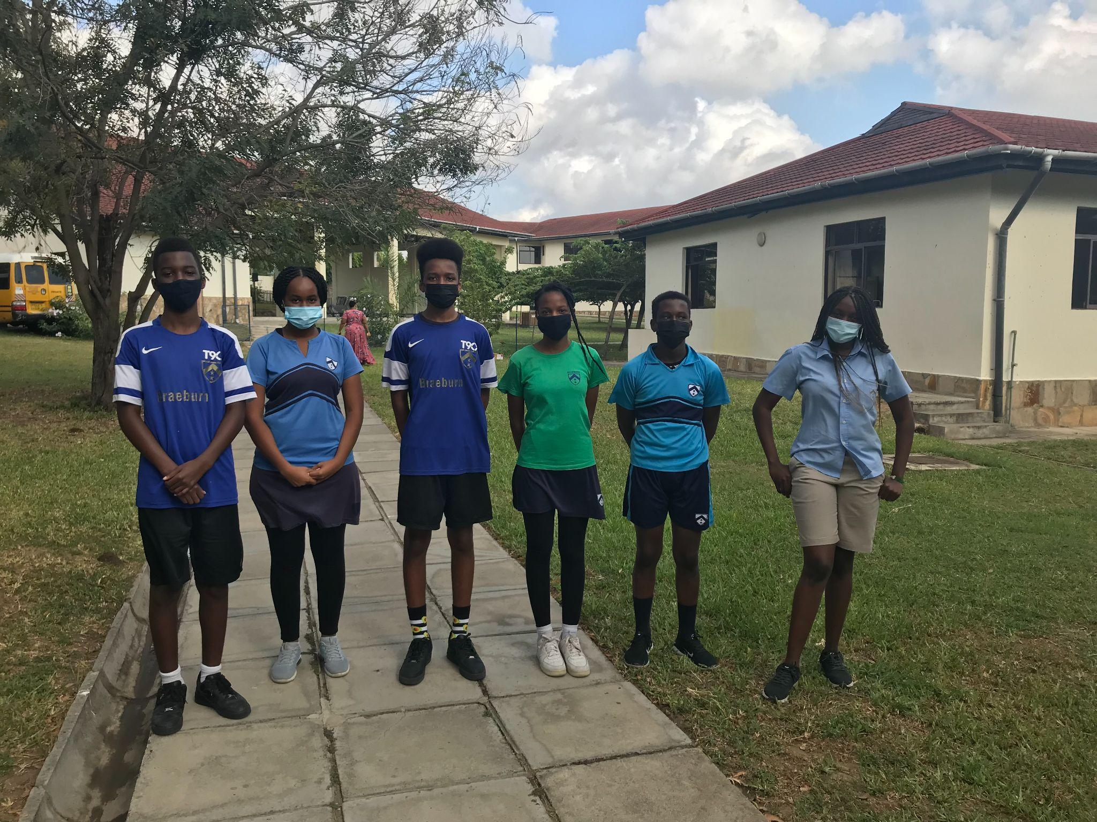
HOUSE CAPTAINS

Slide 2
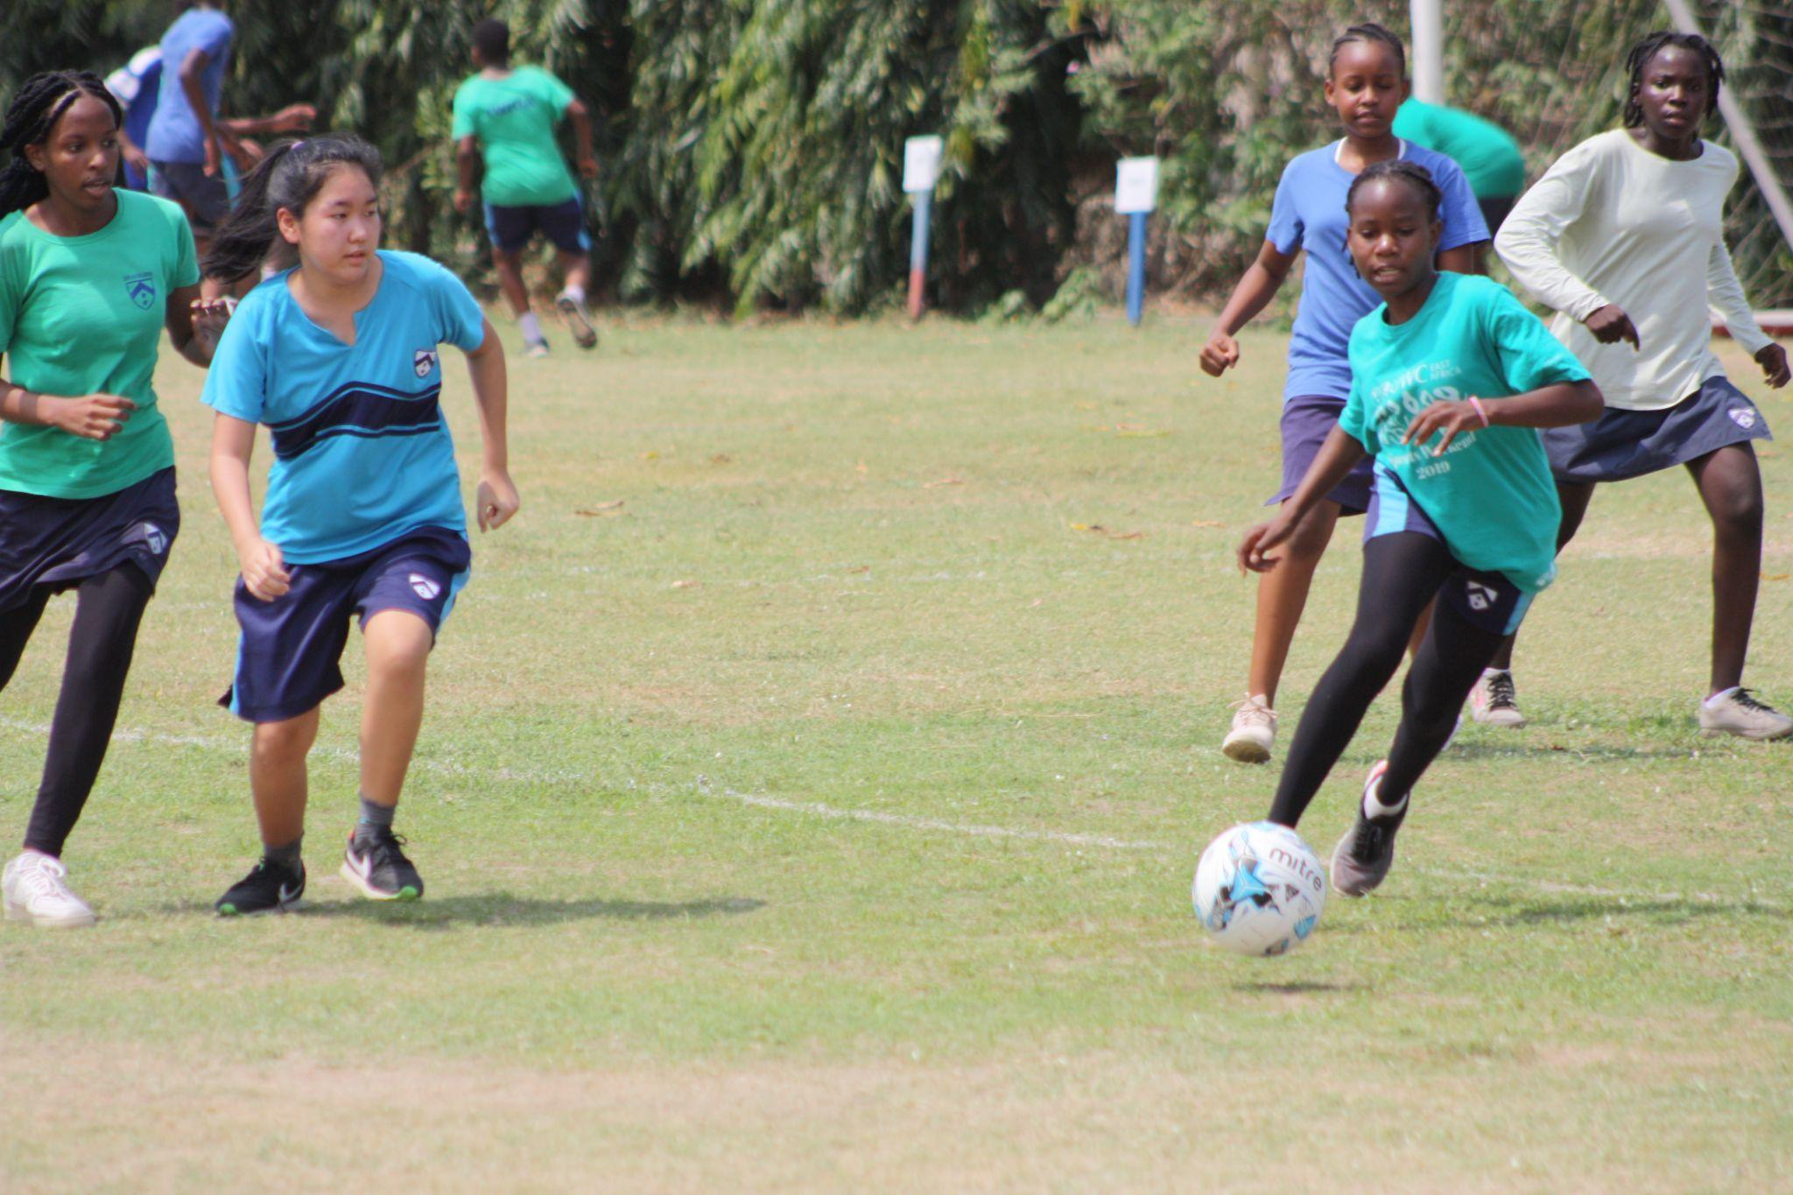
I
N
T
E
R
H
O
U
S
E

Slide 3
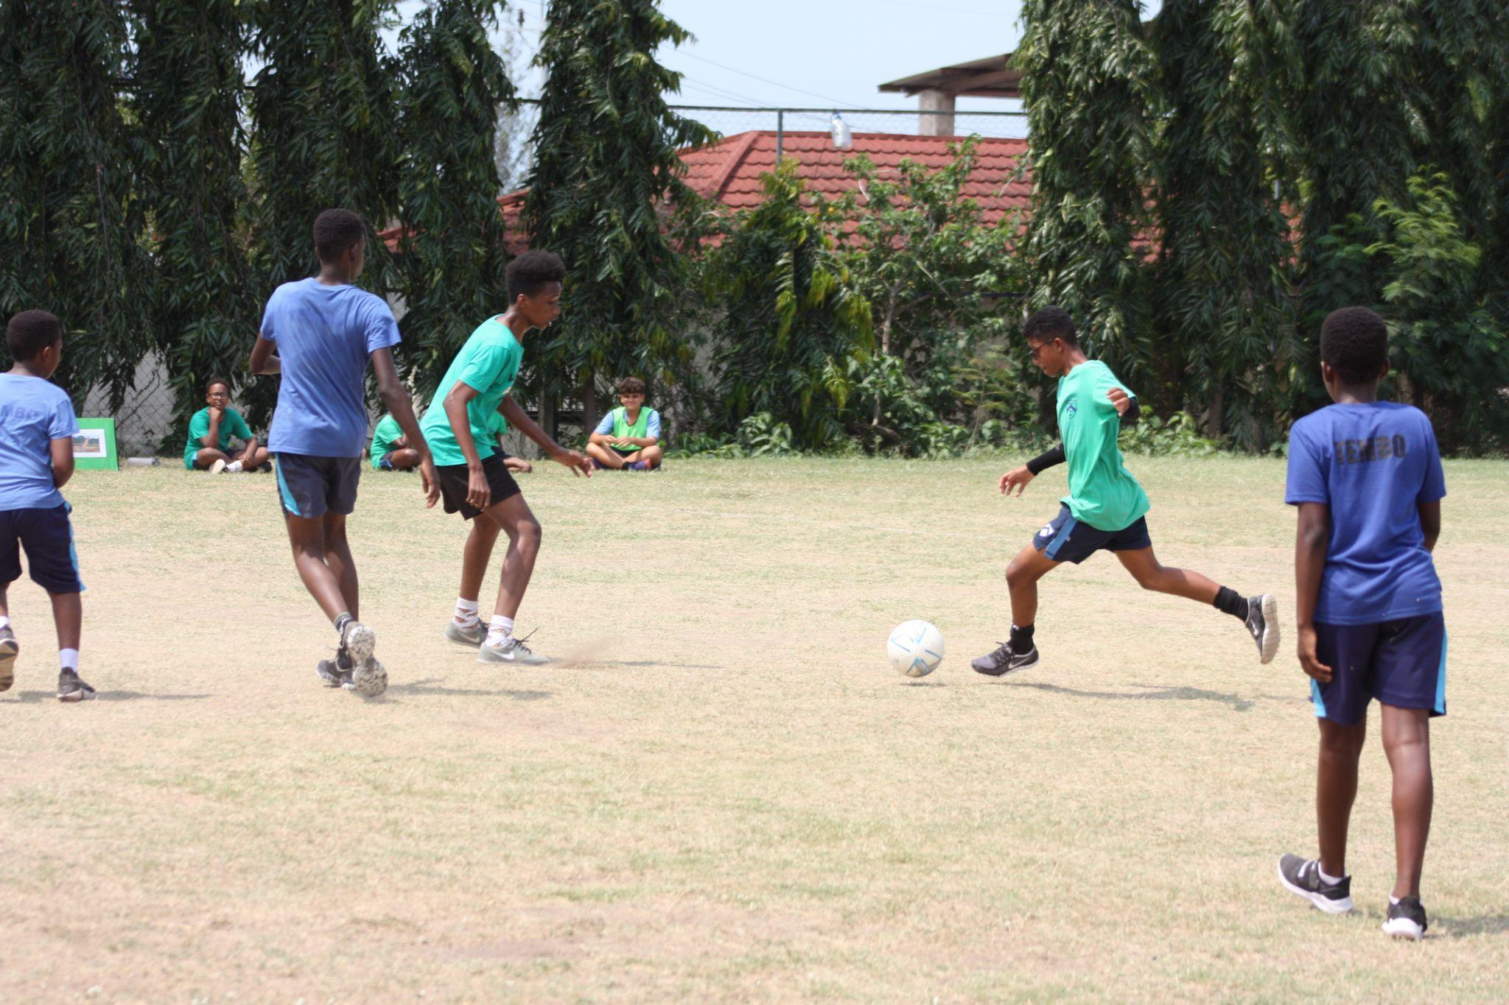

Slide 4
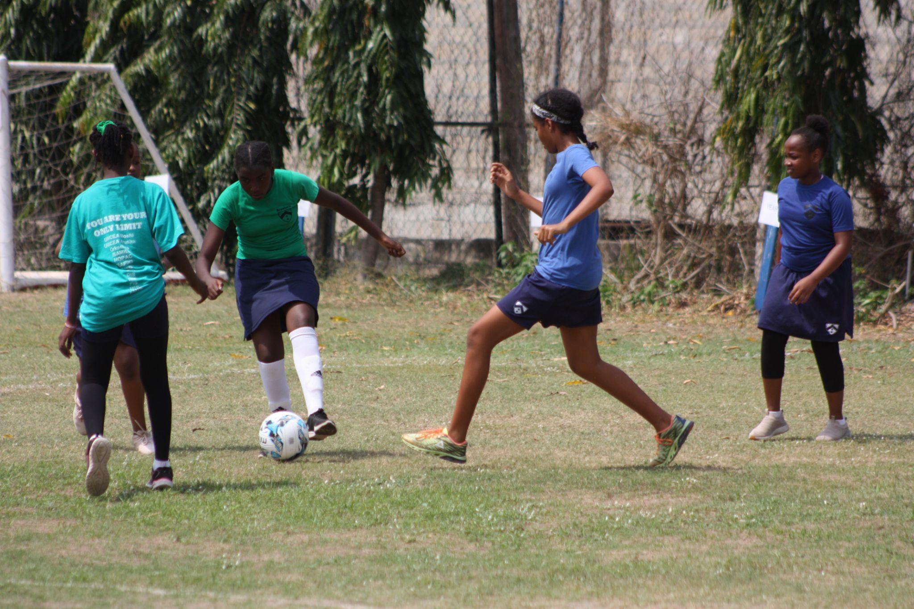

Slide 5
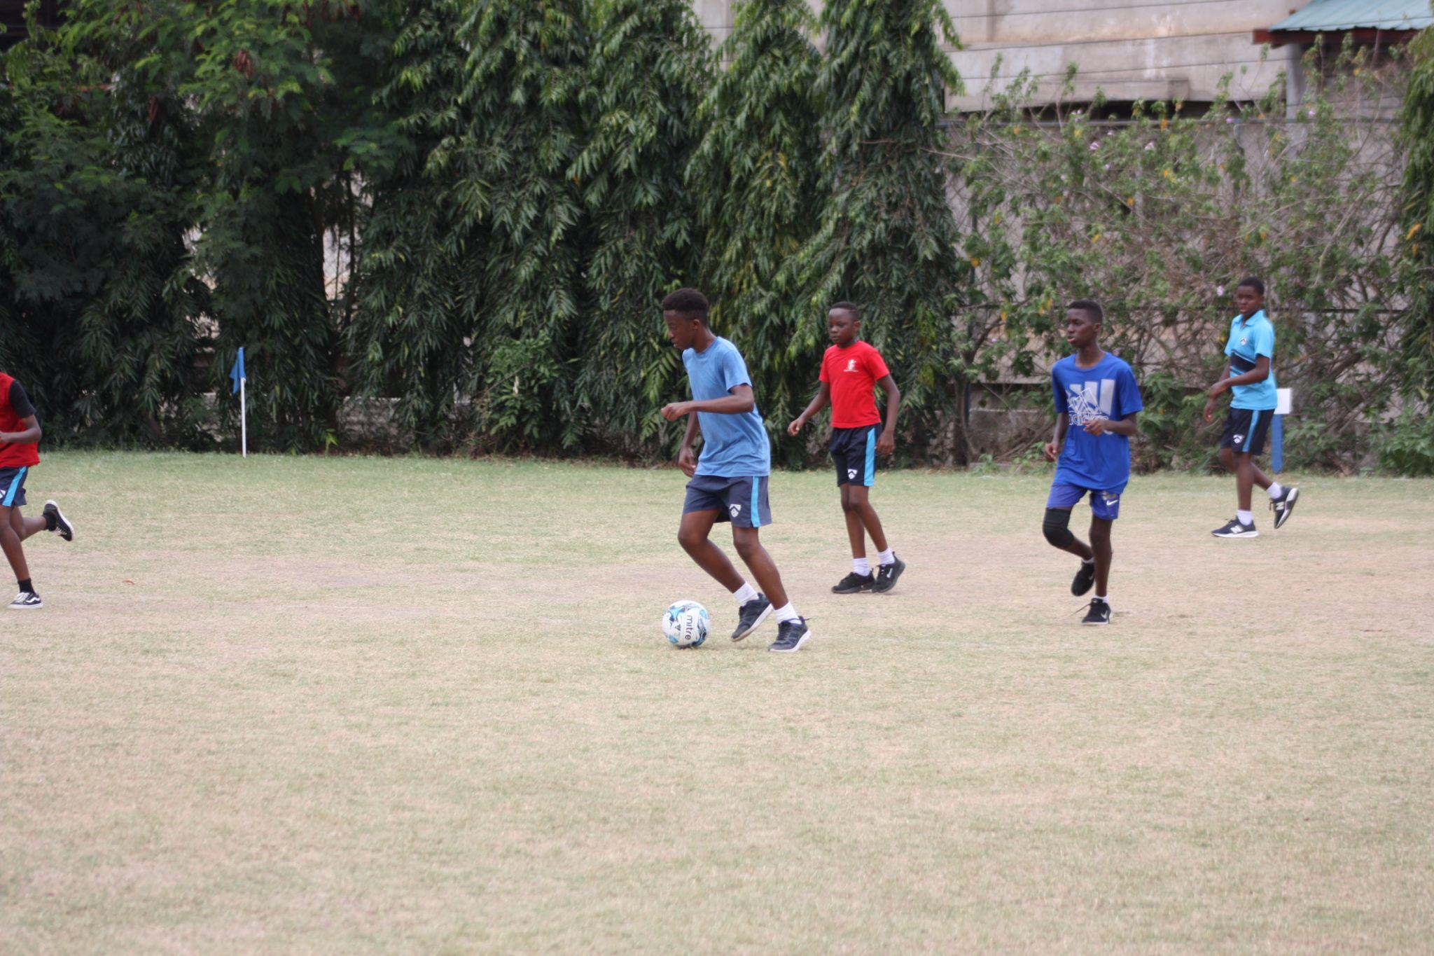

Slide 6
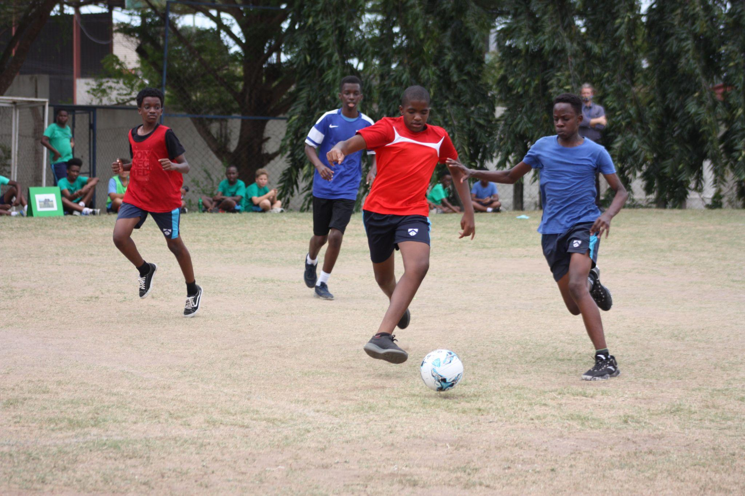

Slide 7
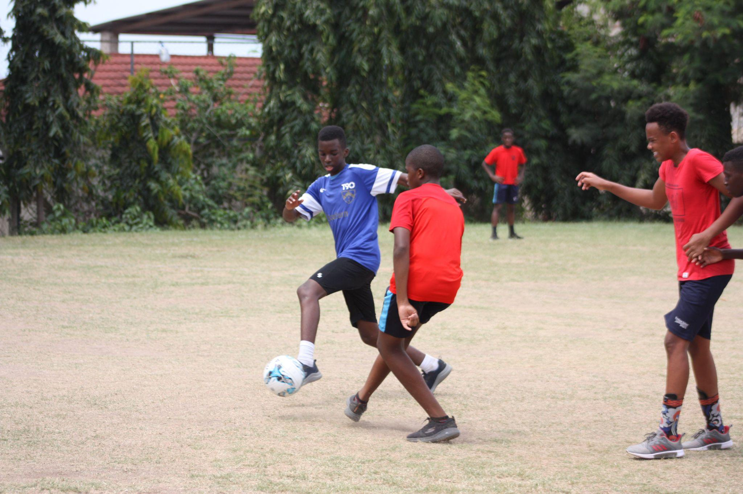

Slide 8
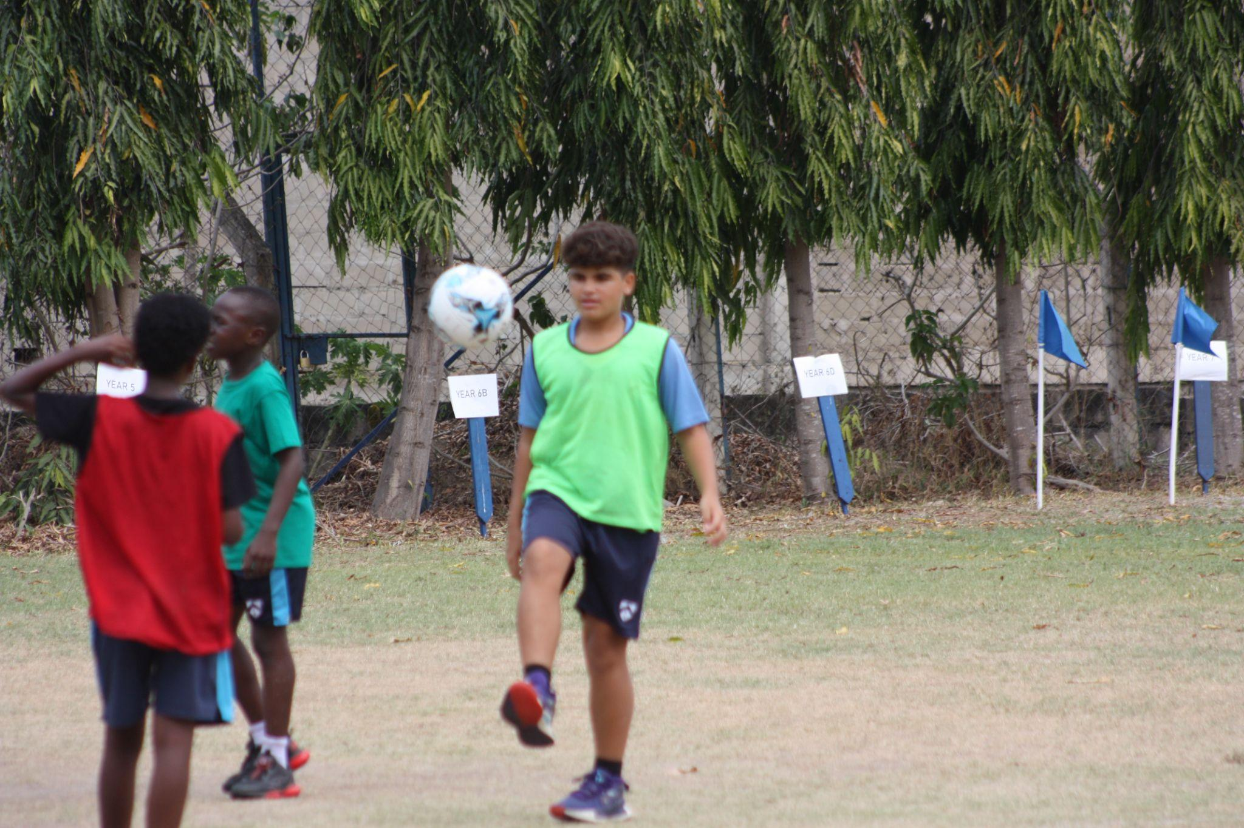
JUGGLING

Slide 9
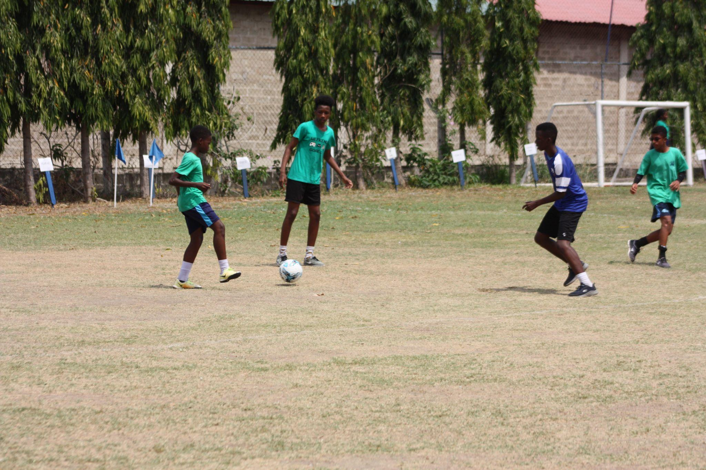

Slide 10
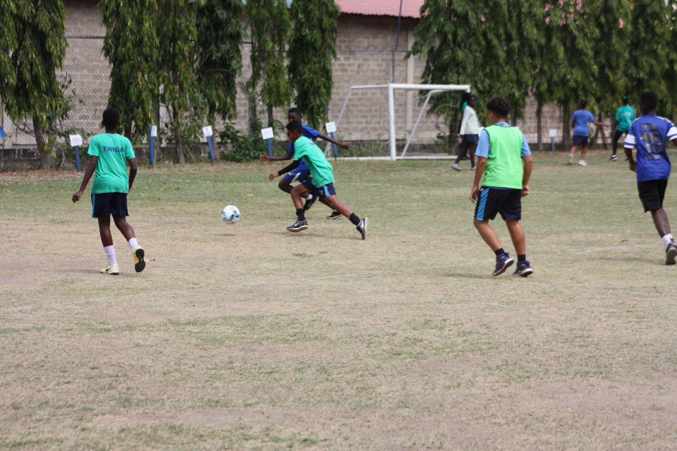

Slide 11
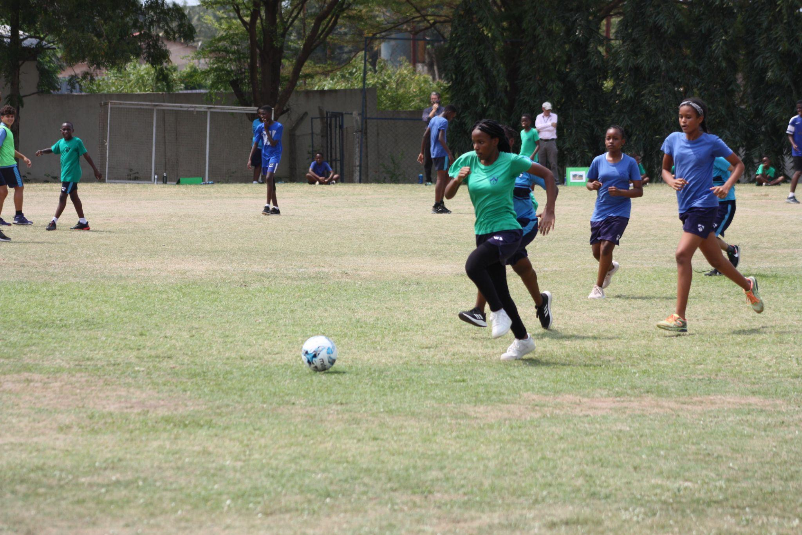
DETERMINATION

Slide 12
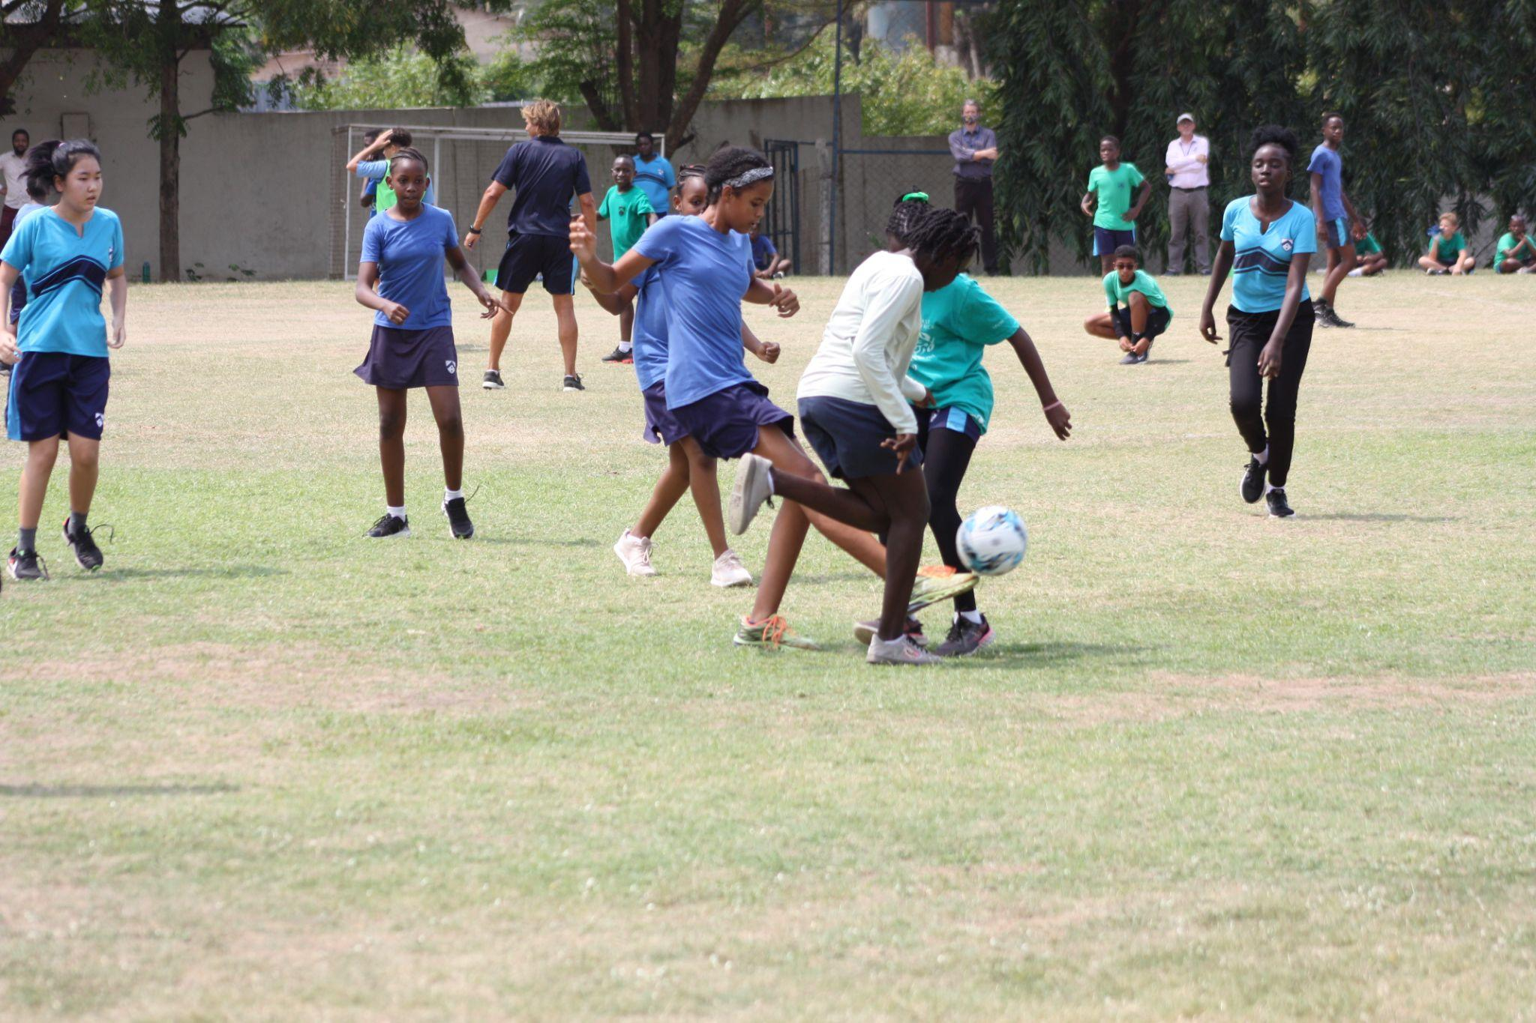

Slide 13
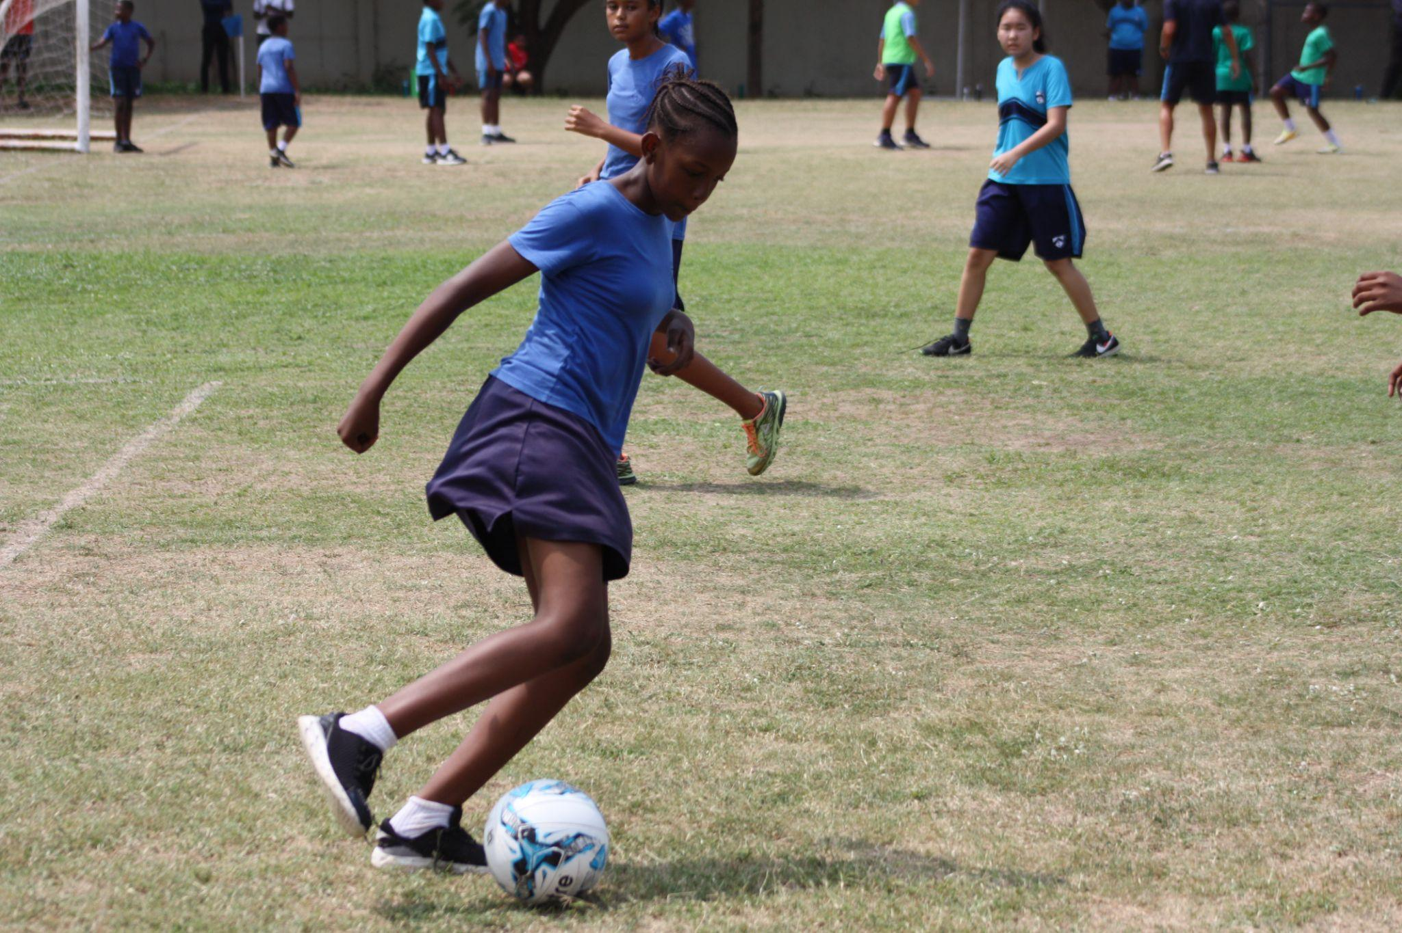
CONTROL

Slide 14
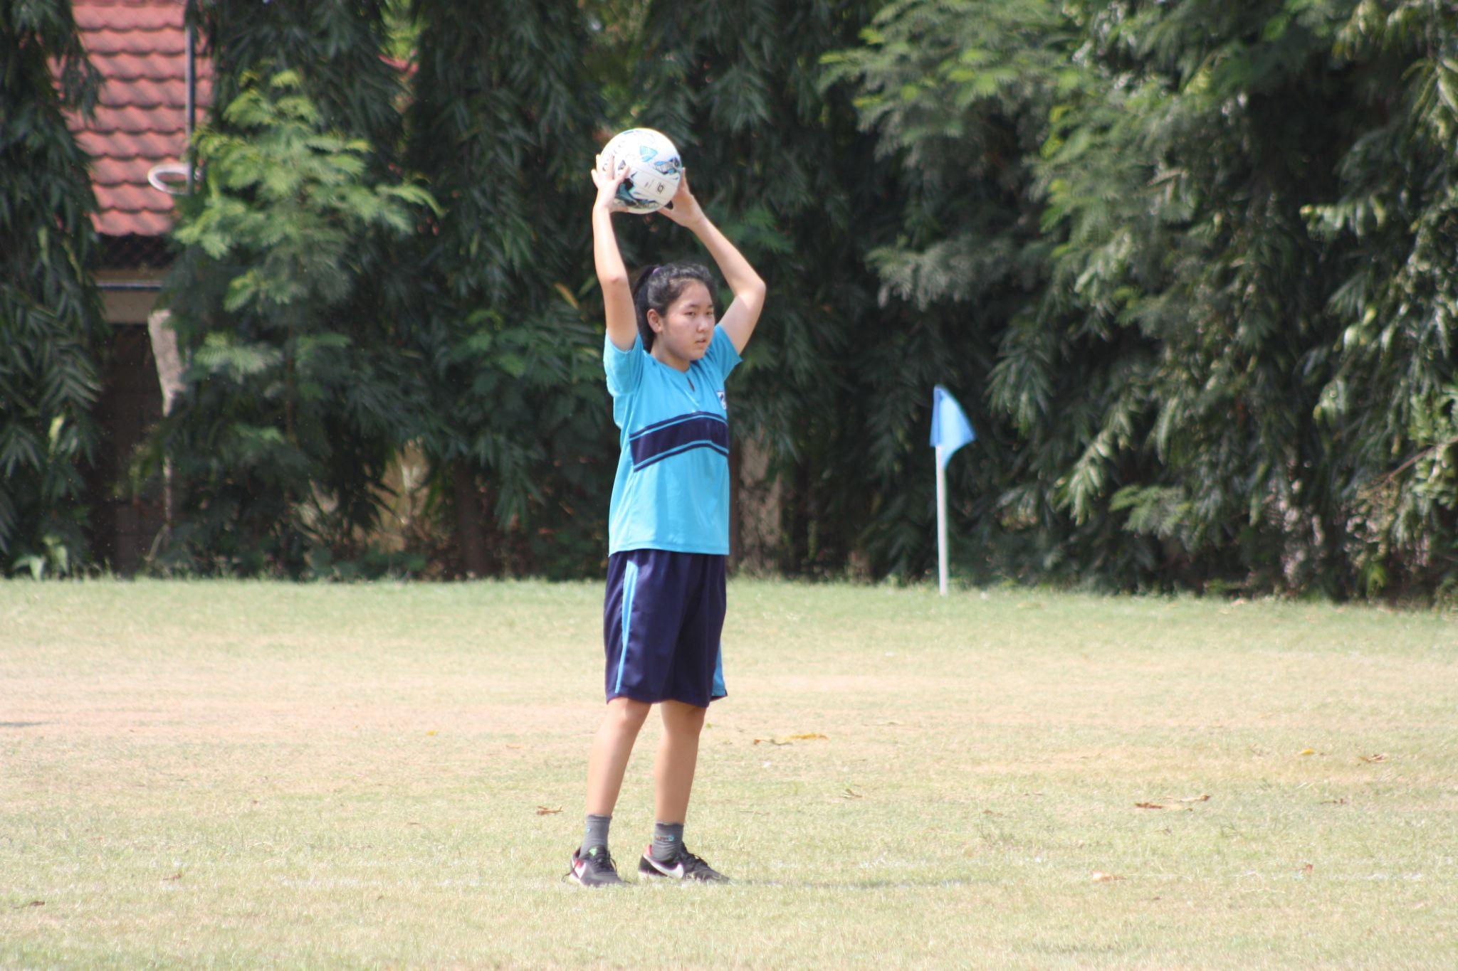
FOCUS

Slide 15
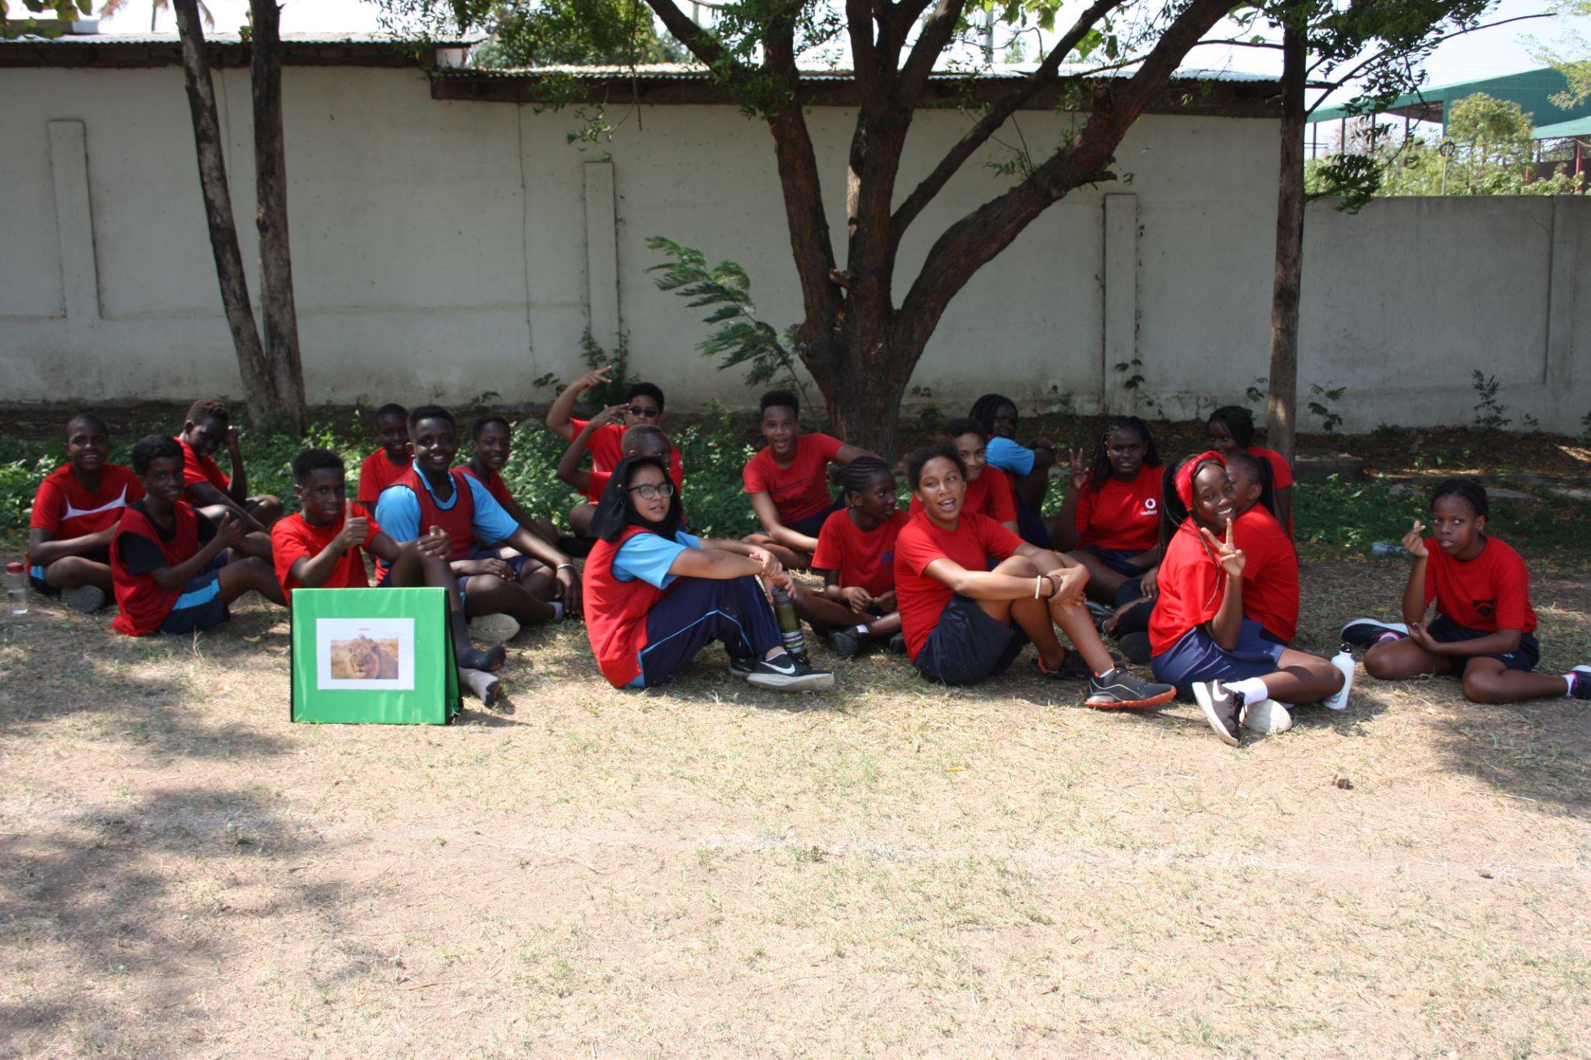

Slide 16
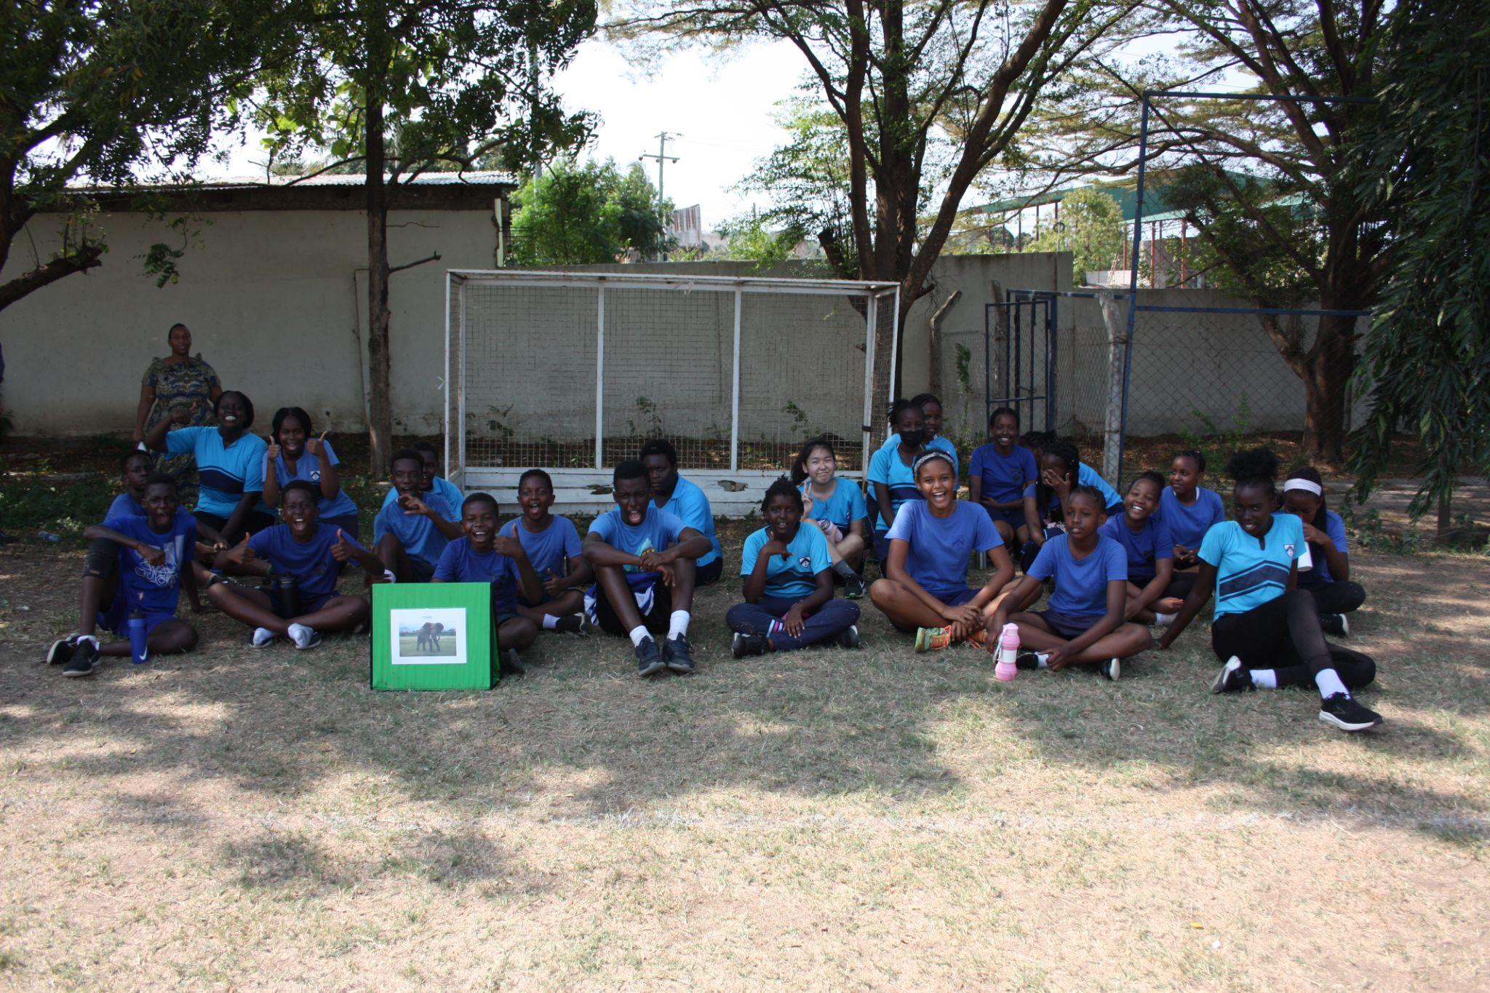

Slide 17
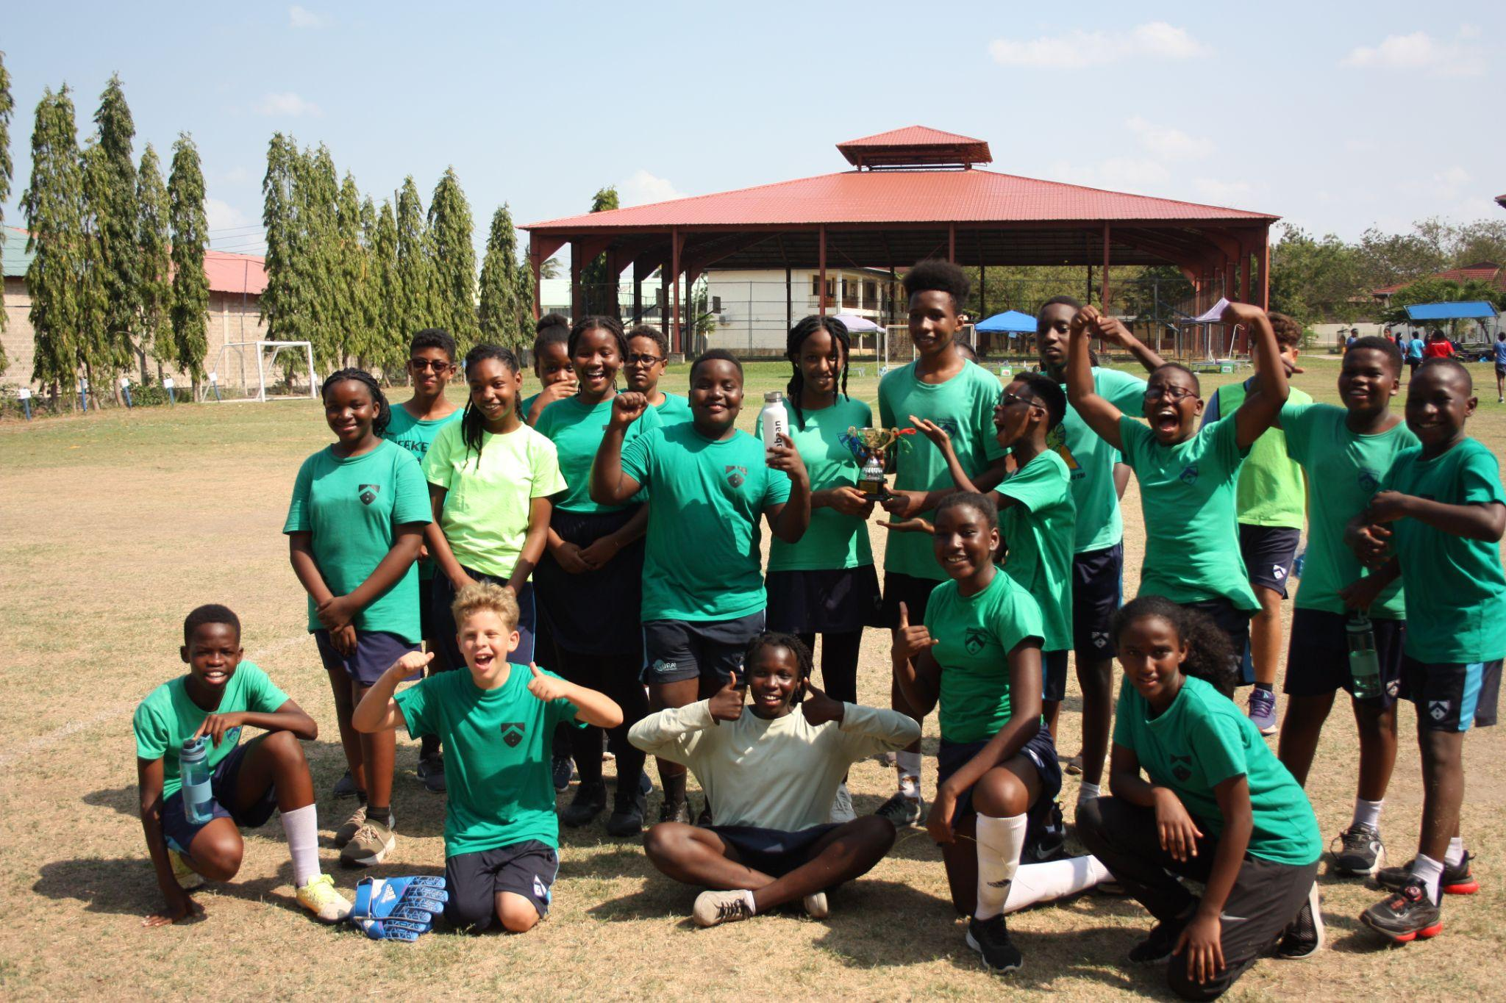
TWIGA SMASHED IT

Slide 18
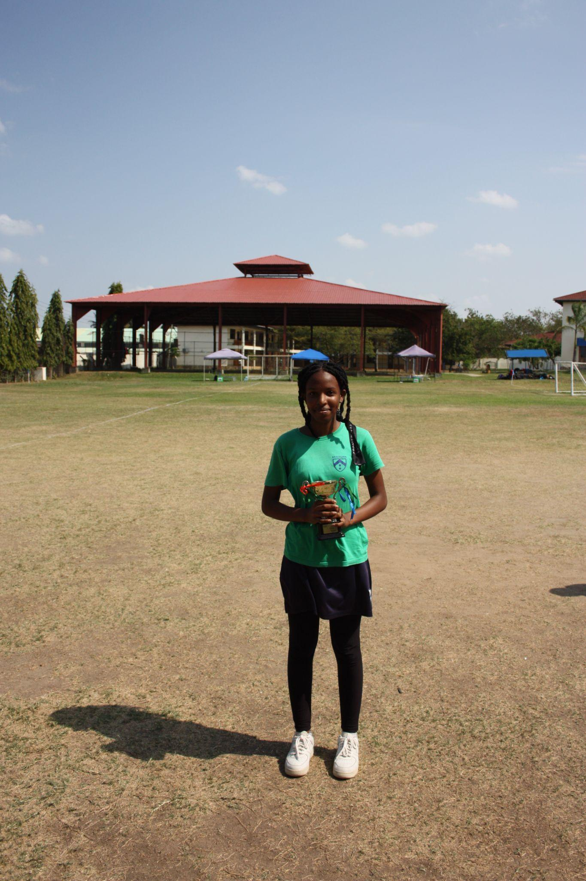
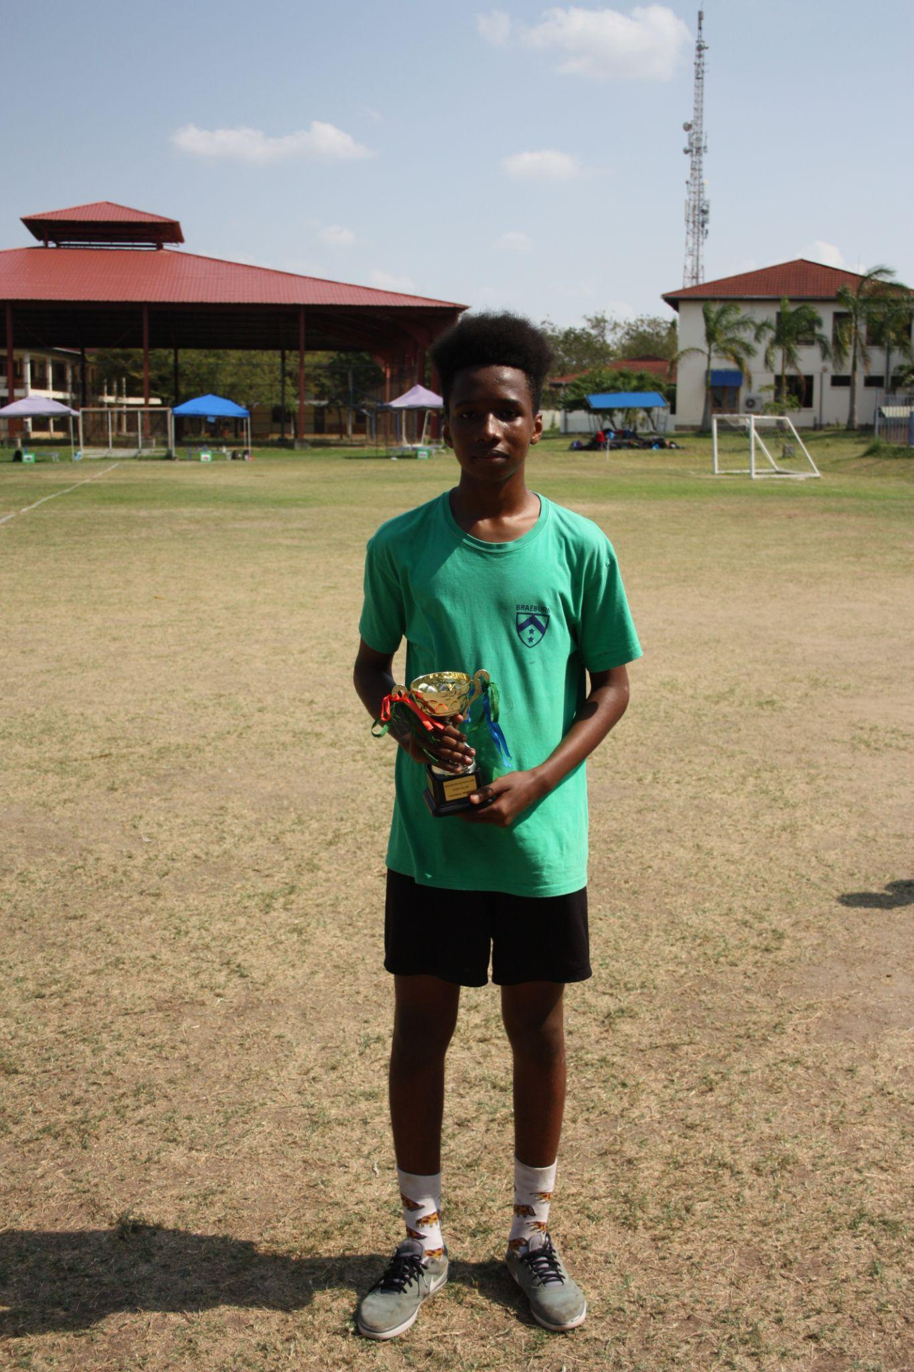

Slide 19
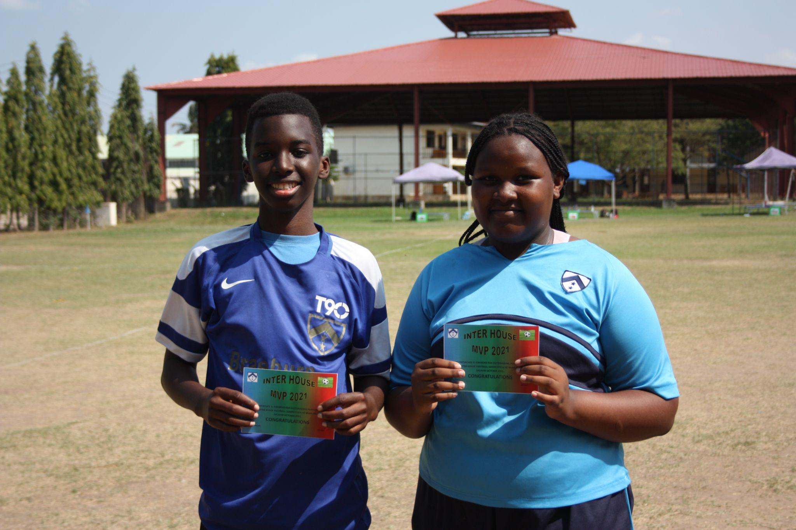
M
V
P

Slide 20
SWIMMING

Slide 21
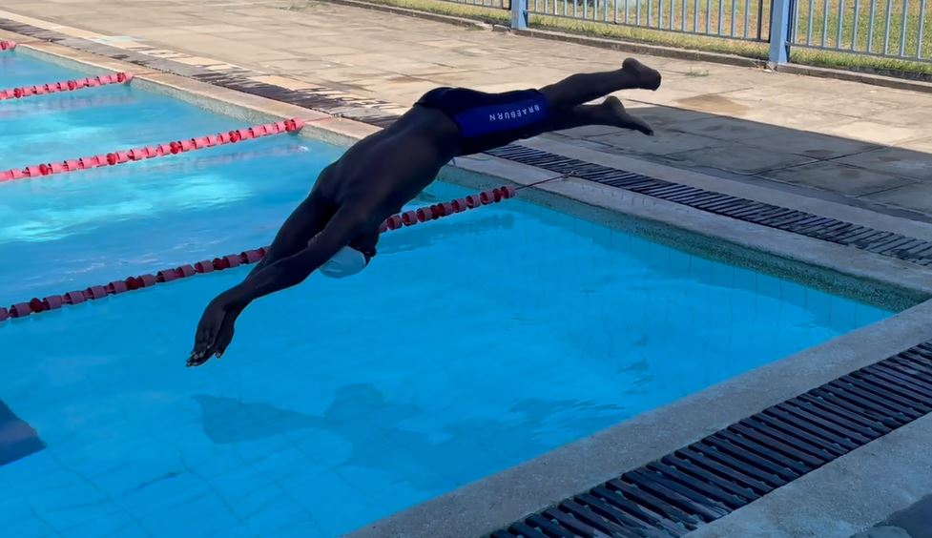

Slide 22
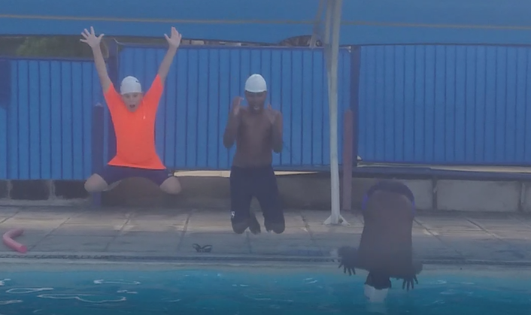

Slide 23
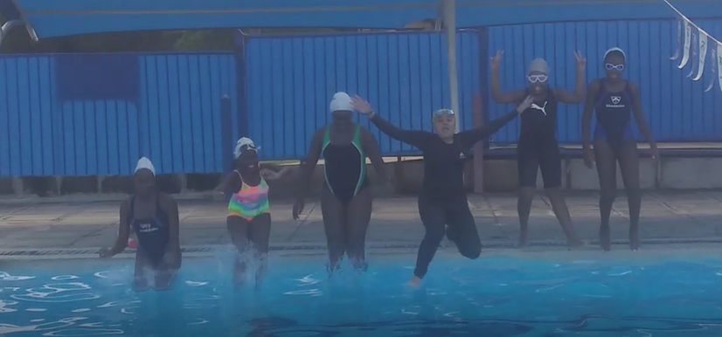

Slide 24
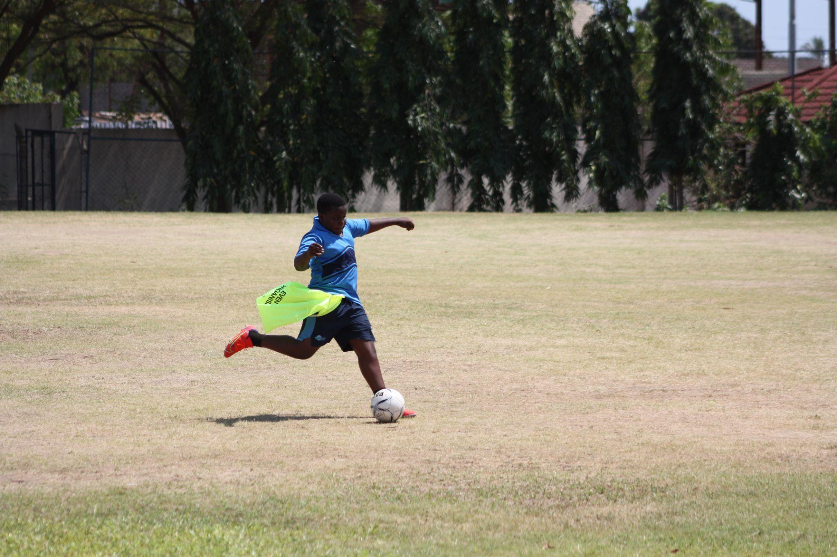
P
E
L
E
S
S
O
N
S

Slide 25
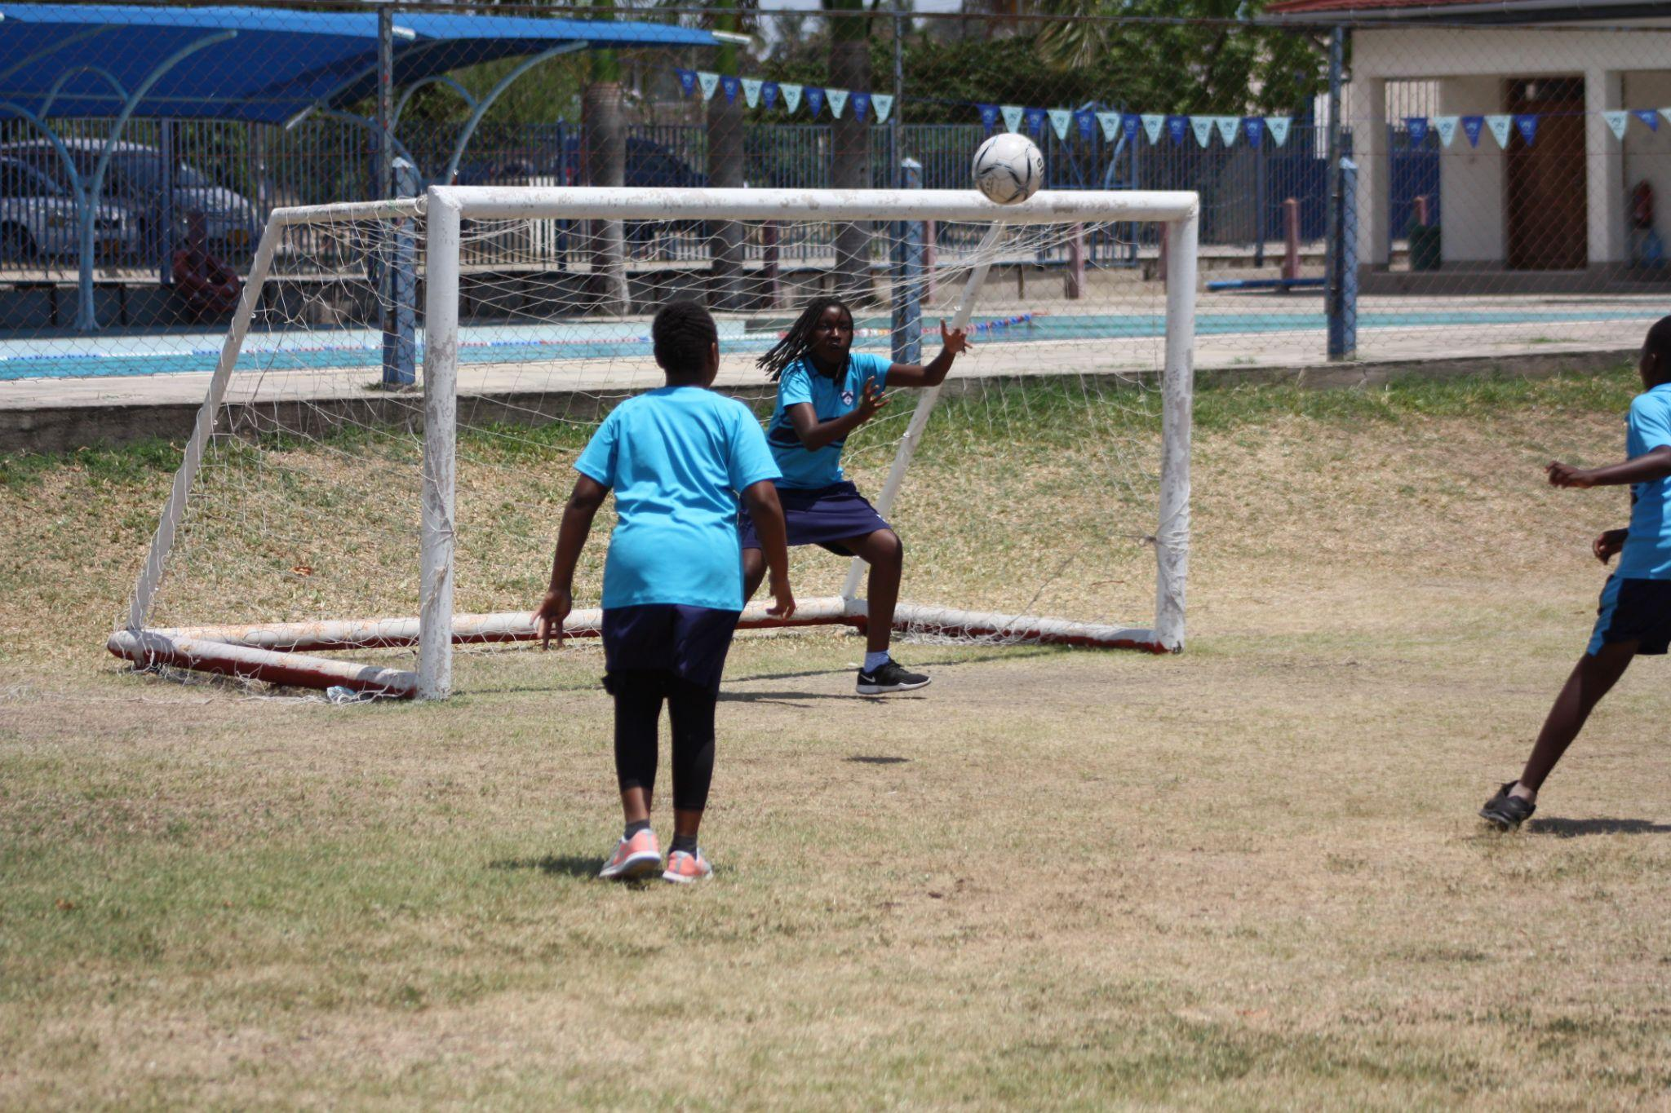

Slide 26
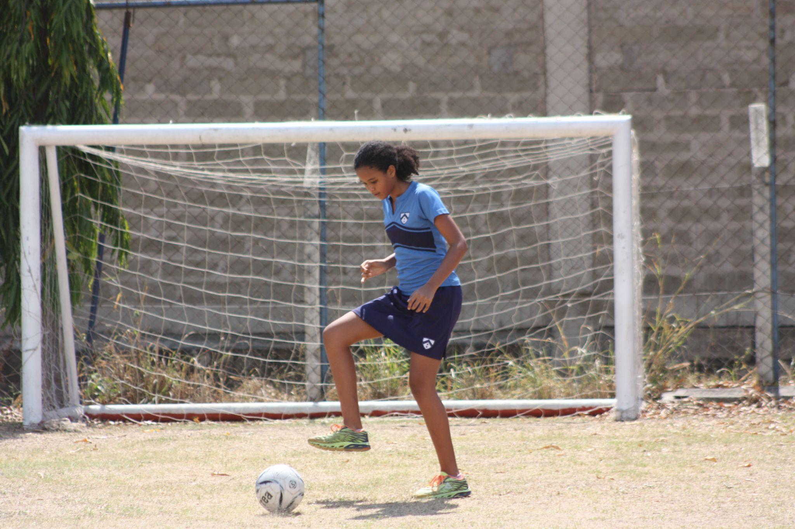

Slide 27
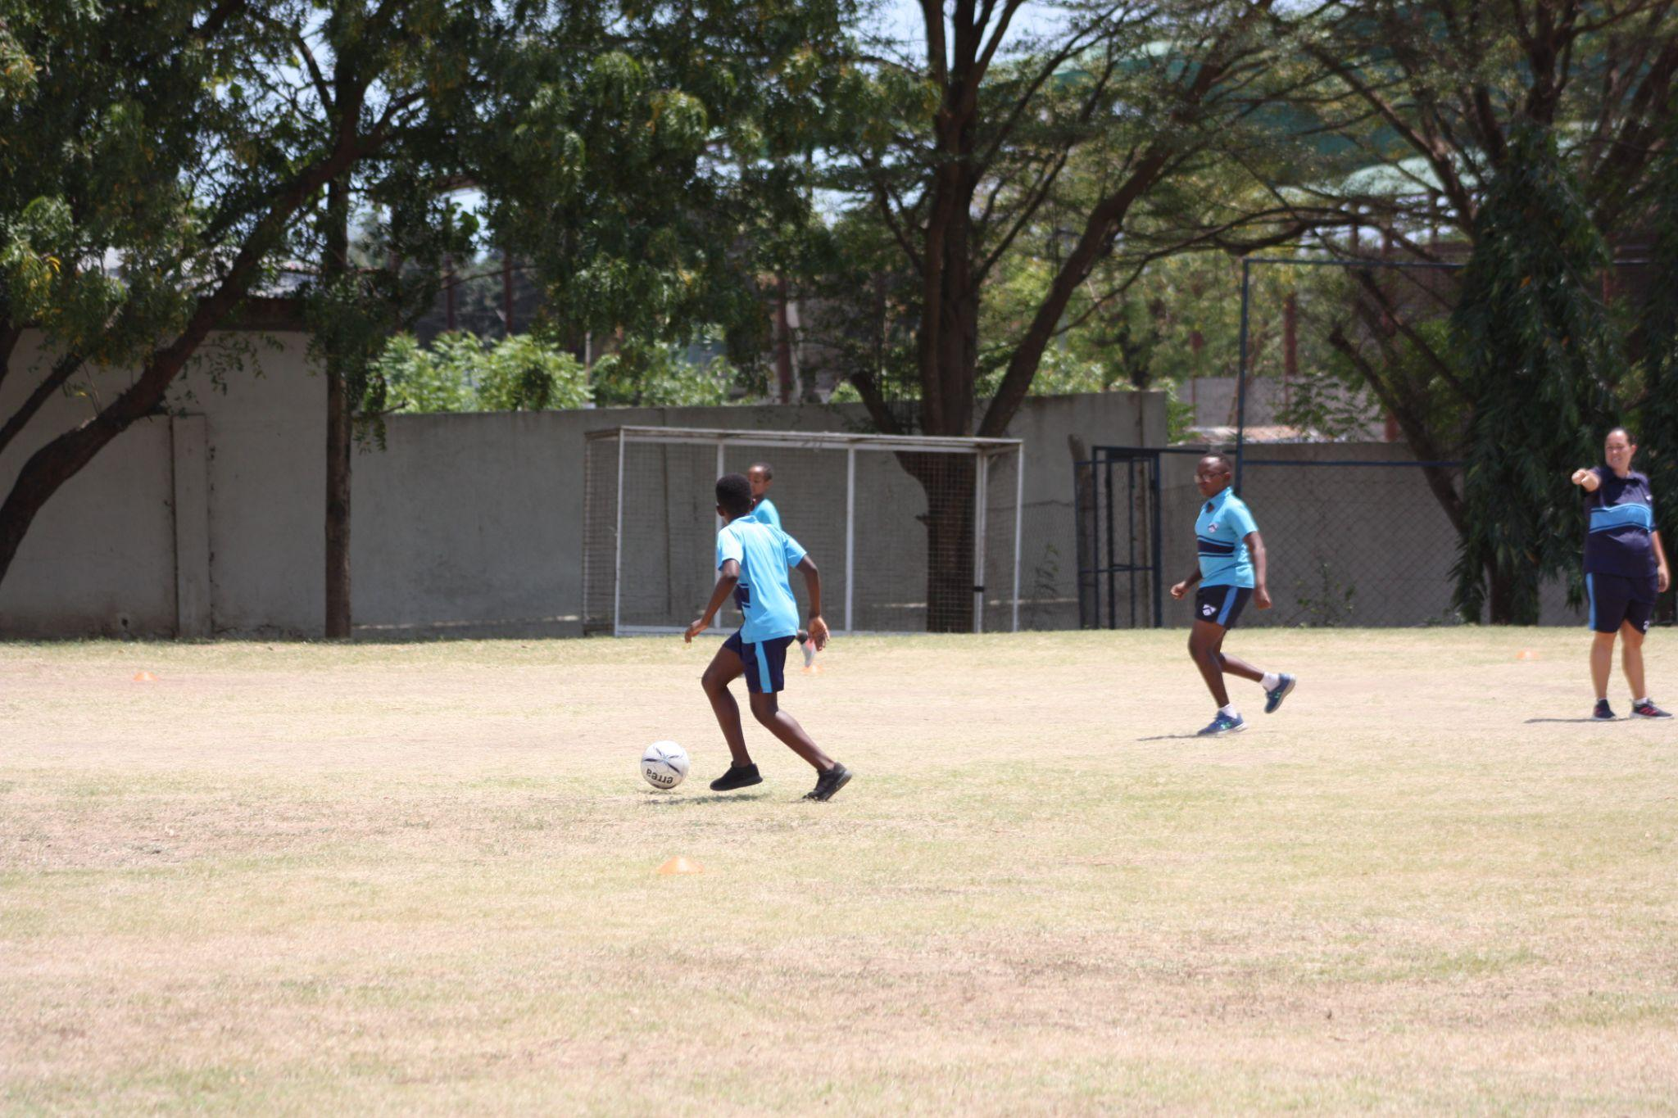

Slide 28
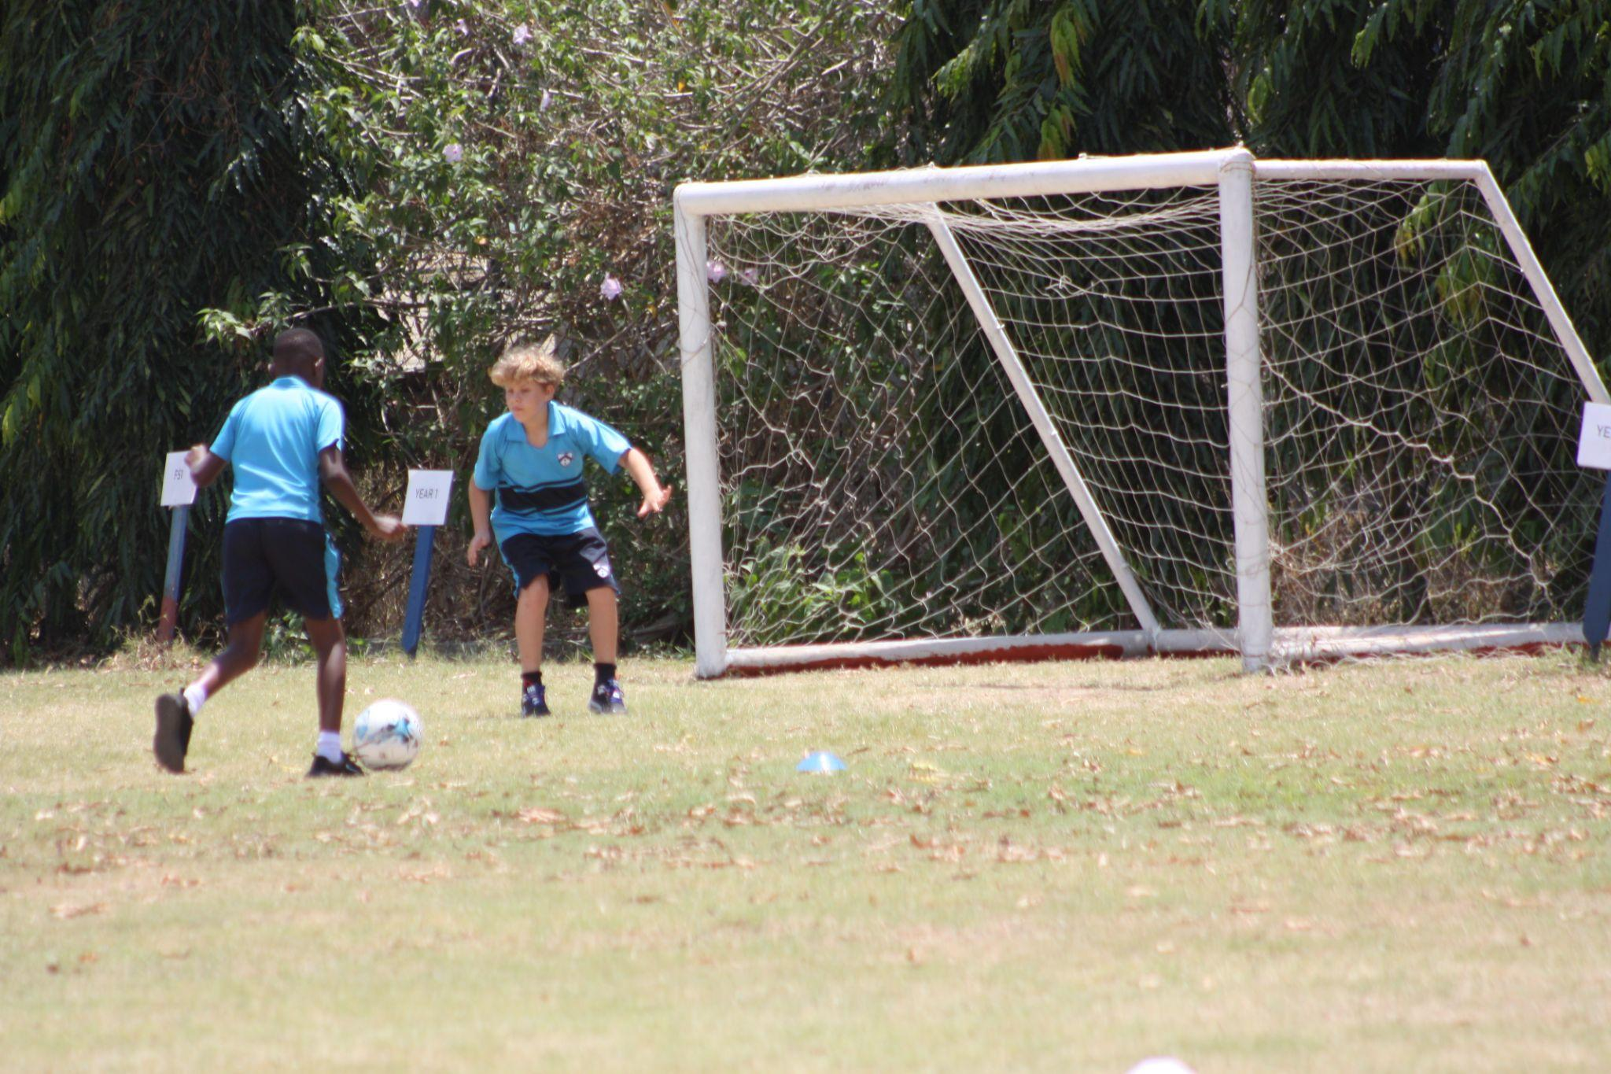

Slide 29
CONGRATULATIONS TO NOVEMBERS MVP'S

Slide 30
GLADYS MREMA
TREVOR GATIMU
For pushing herself outside of her comfort zone and joining the football team. For her determination in lessons and making huge progress in her tennis and football skills. Well done Gladys
For his hard work and dedication in all of his lessons. His commitment to the football team and always striving to improve. He has demonstrated some excellent leadership skills.

Slide 31
FROM THE WHOLE PE DEPARTMENT, THANK YOU FOR A WONDERFUL TERM. MERRY CHRISTMAS

