Slide 1
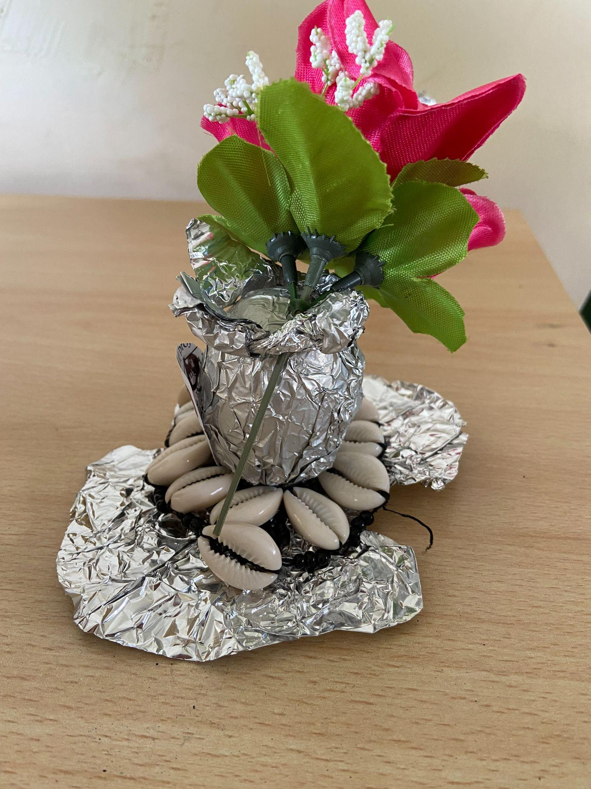
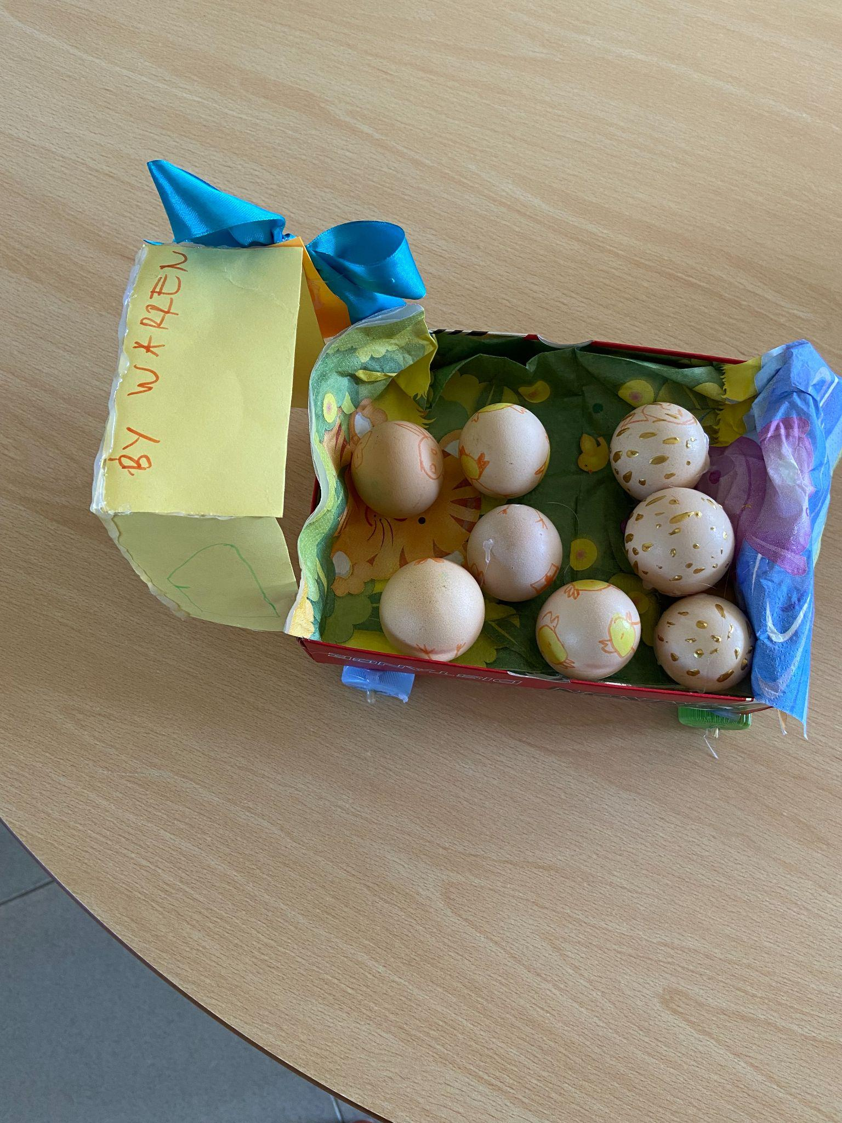
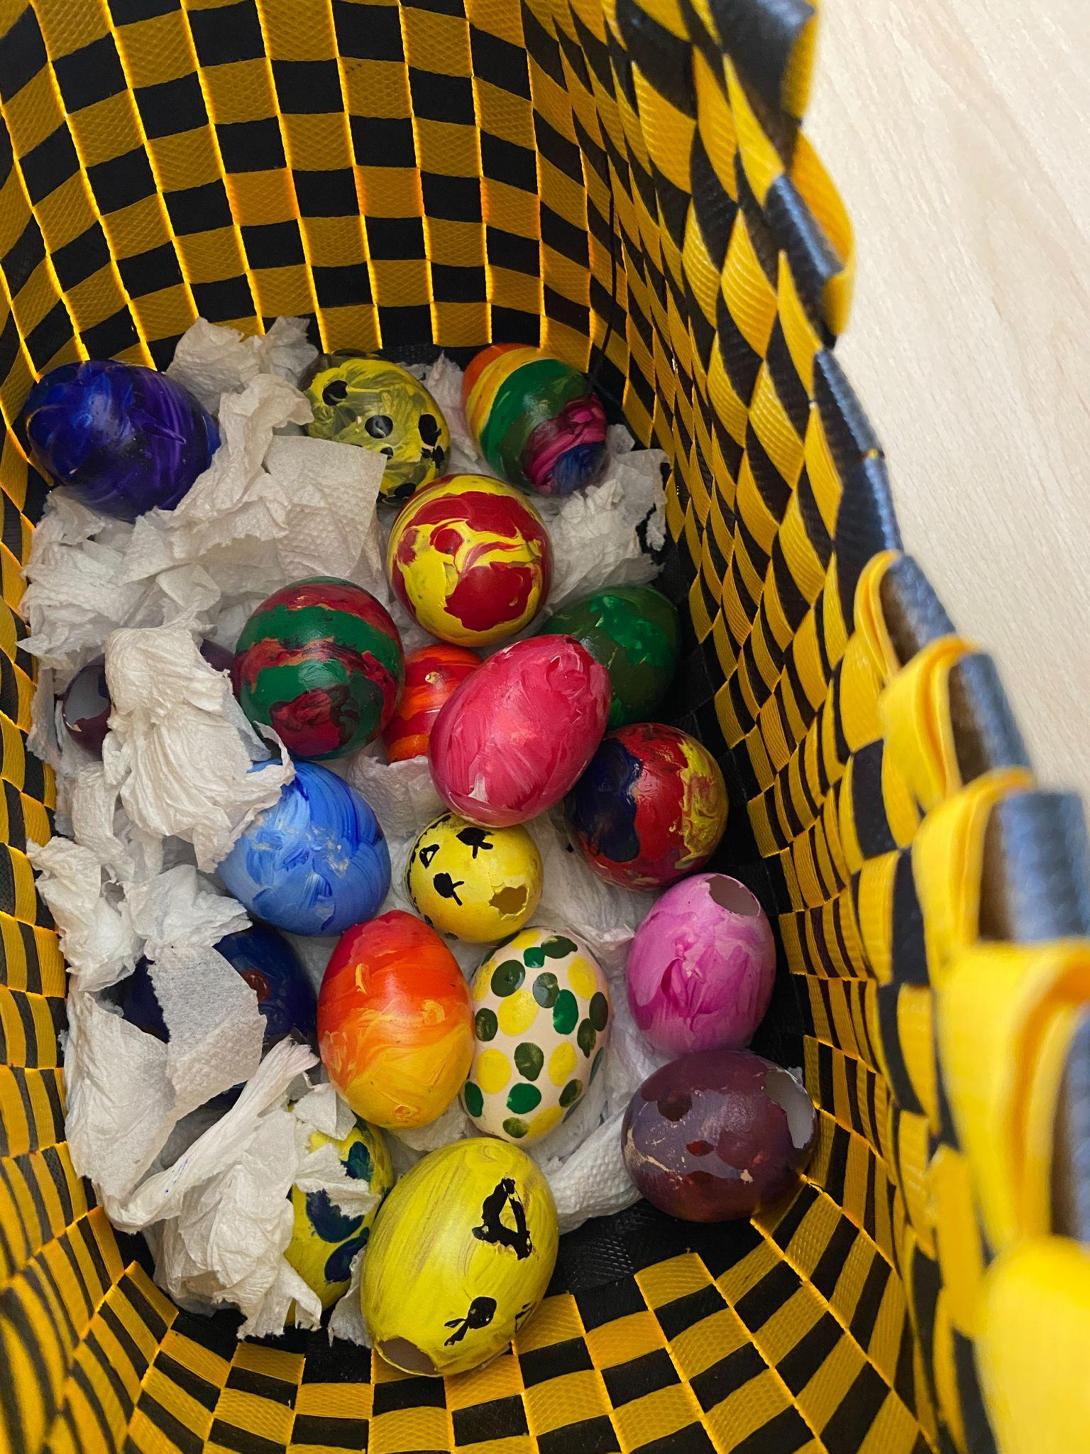
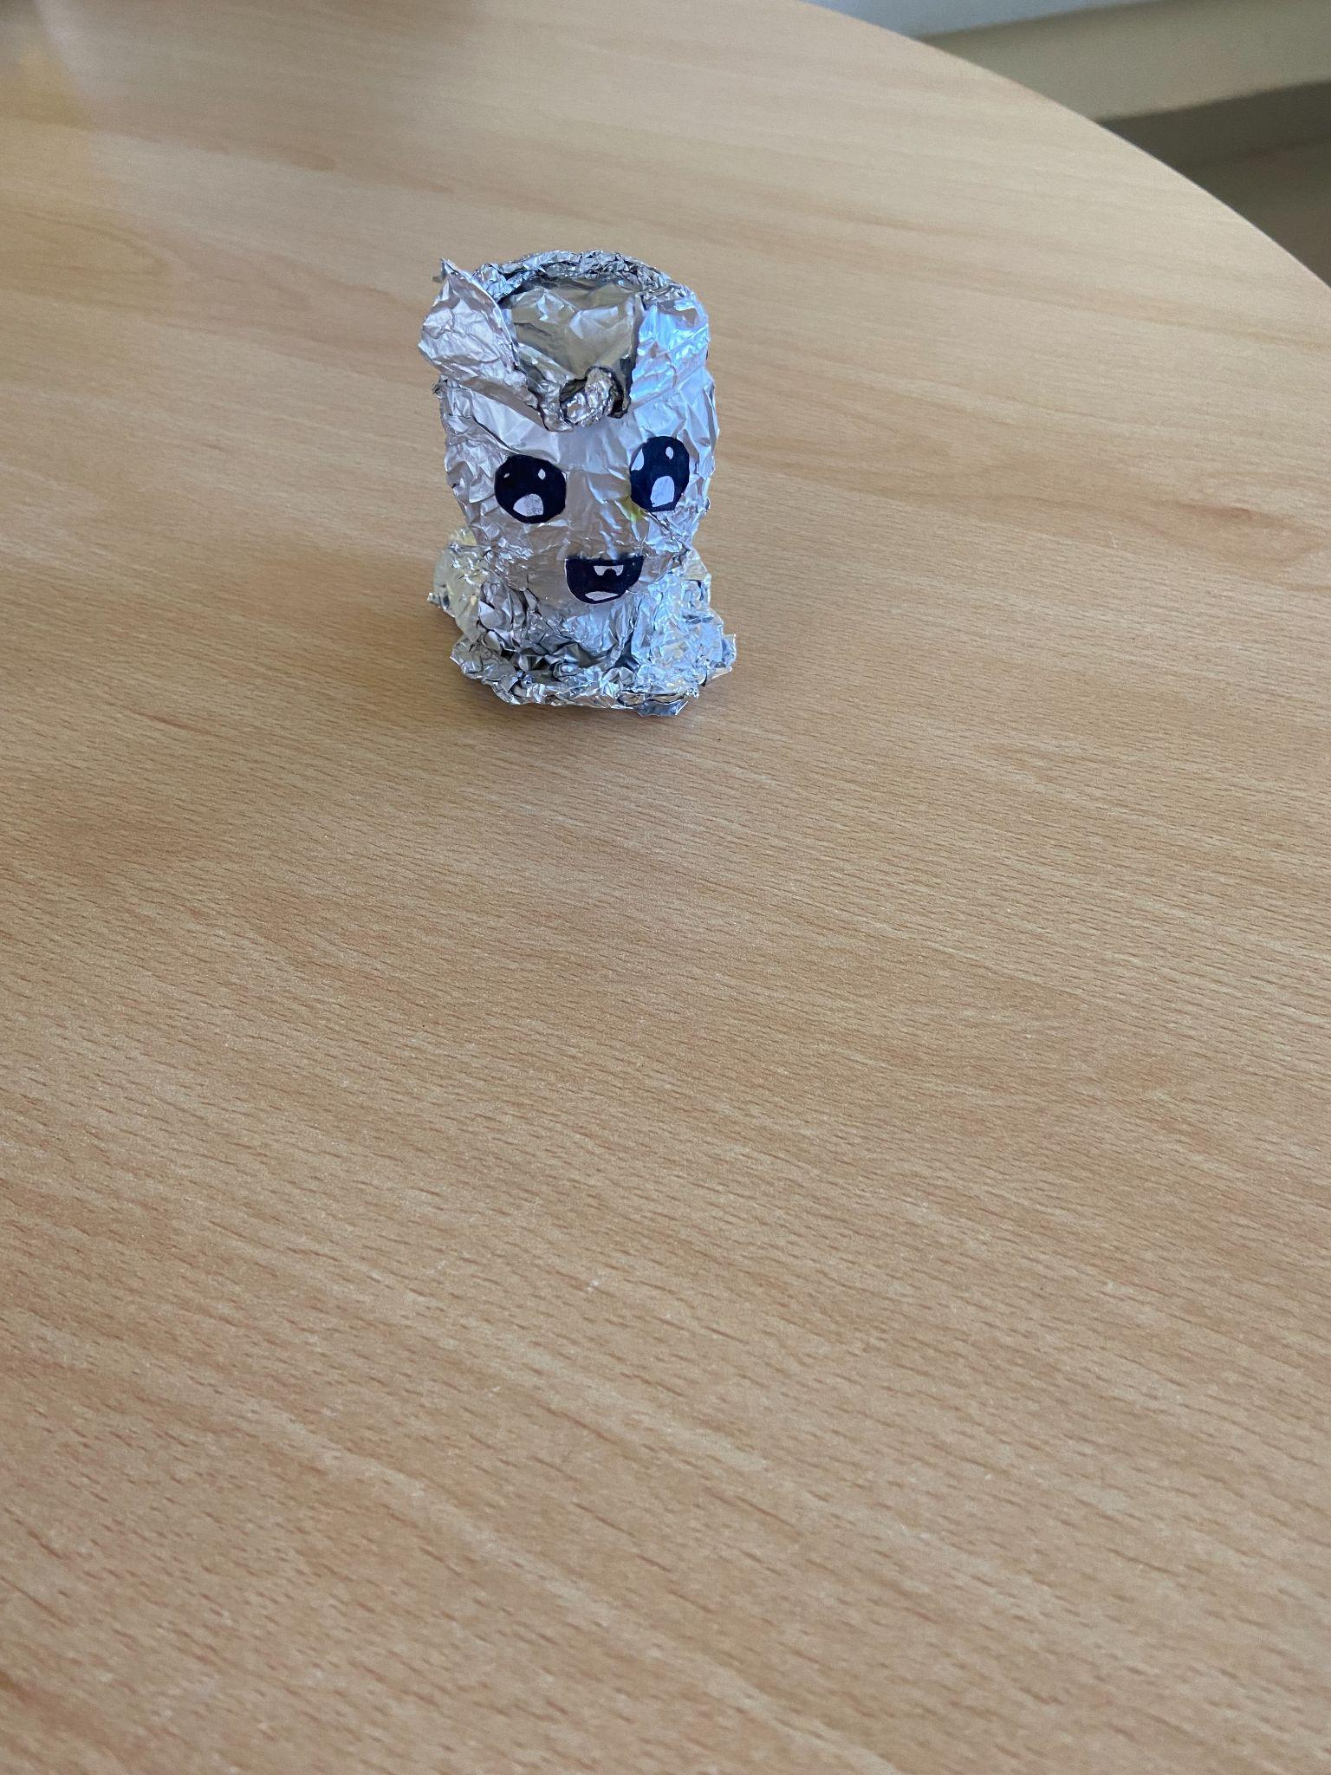
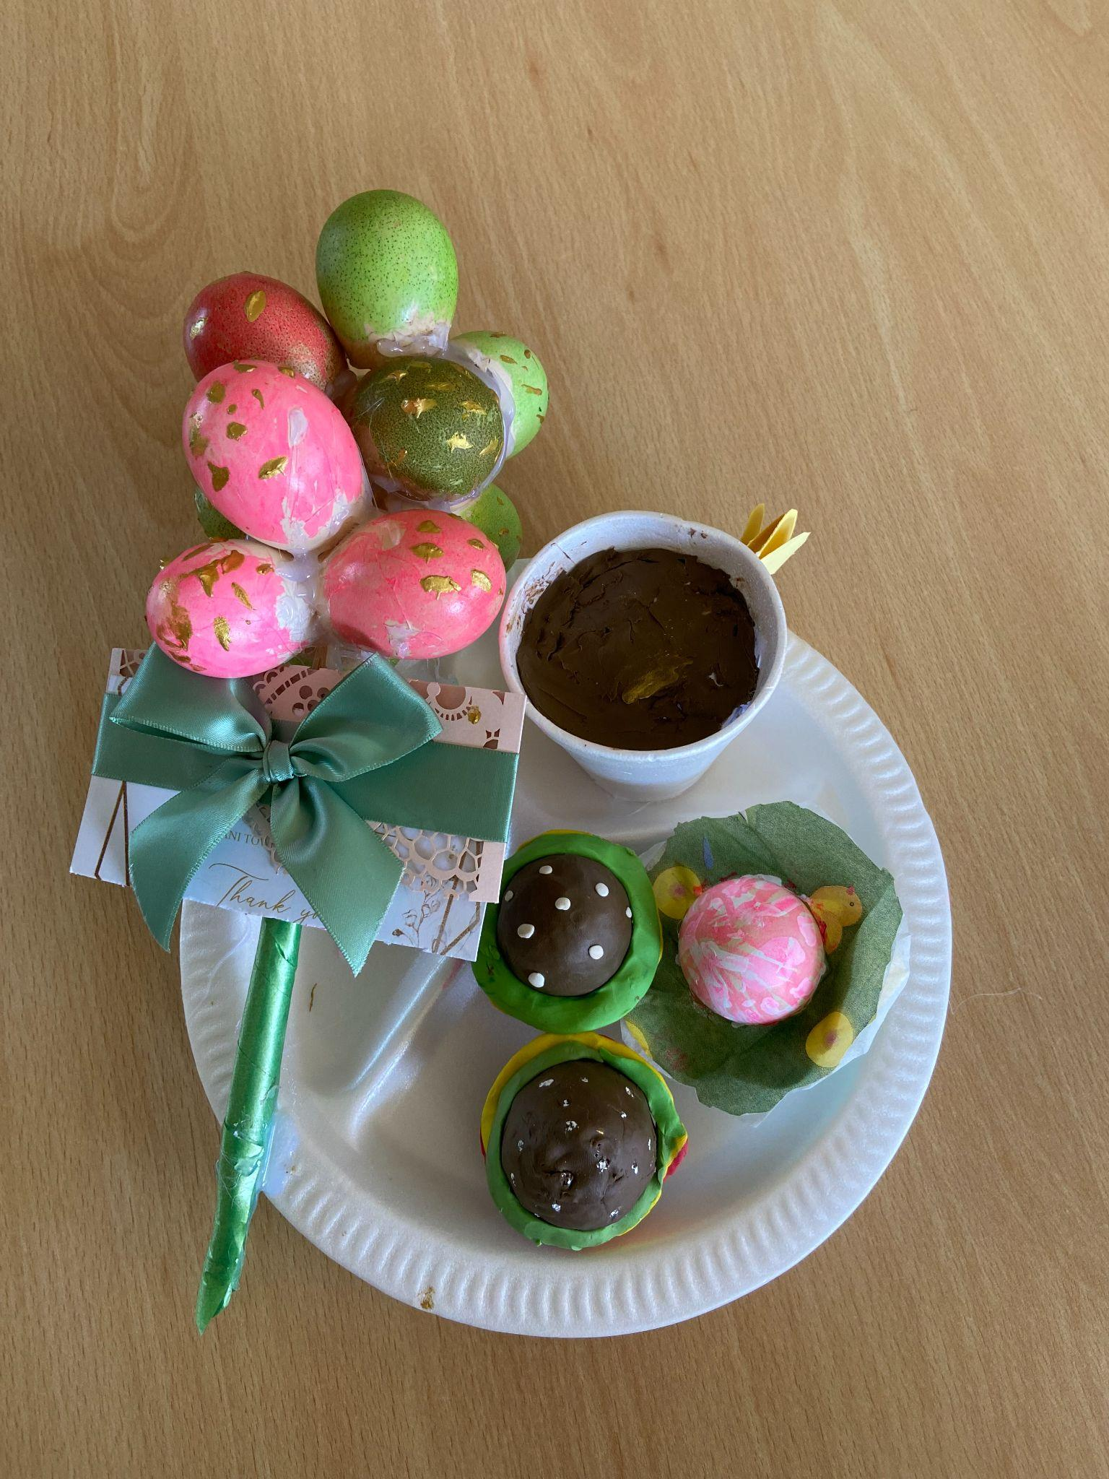
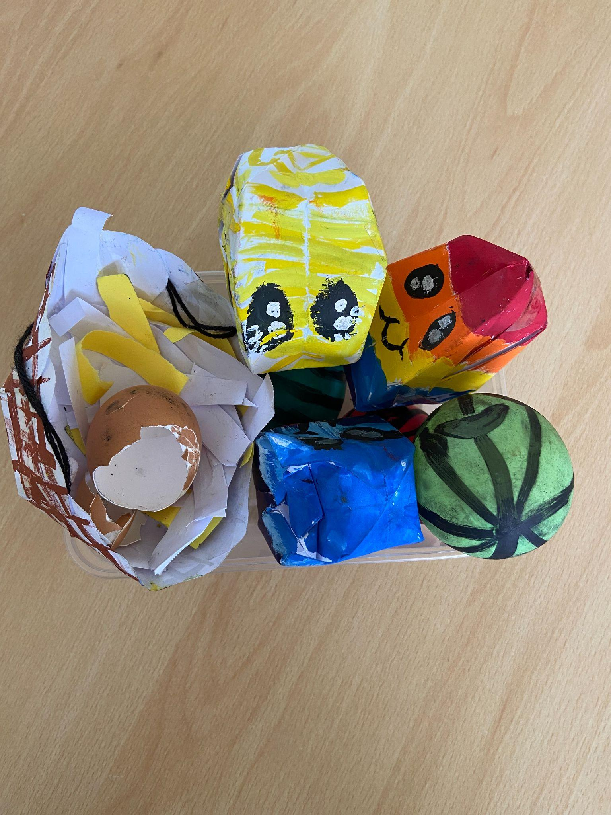
Egg-cellent Egg Creations!
Karlpeter, Suri-Star, Alba & Anaya
Warren
Gwandumi
Liya
Sharon
Baebkal
Sophia
Surya
Miss Igogo
Michelle

